Slide 1
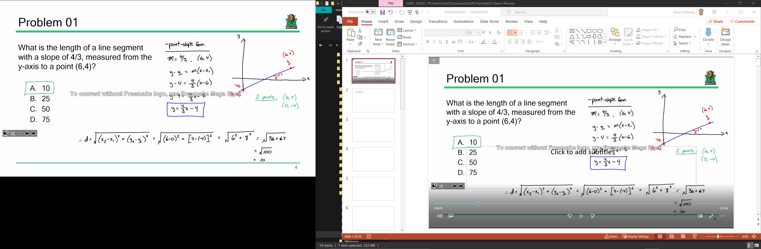
Problem 1
10
25
50
75

Slide 2
Problem 1
Page 35

Slide 3
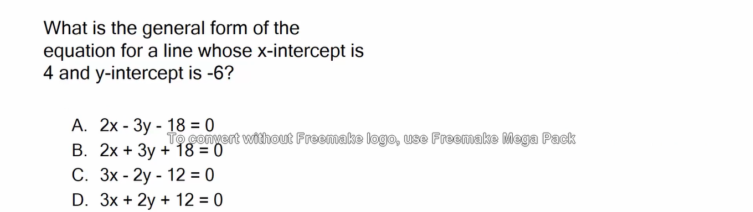
Problem 2

Slide 4
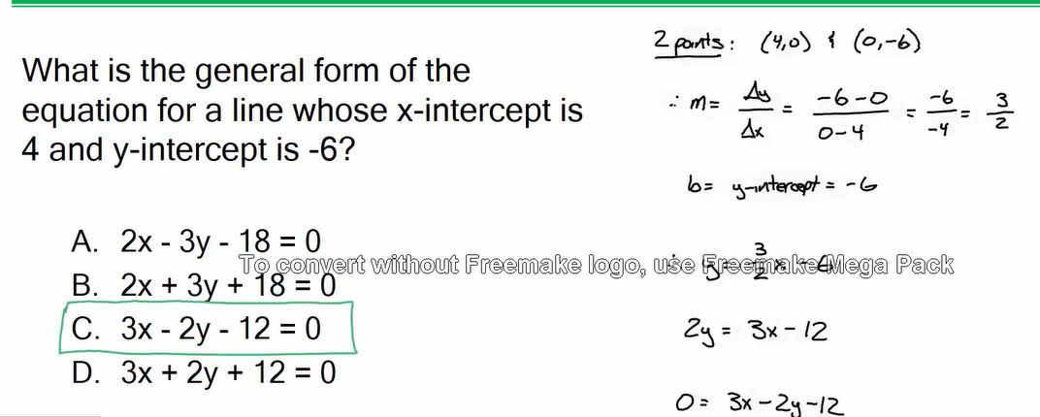

Problem 2

Slide 5
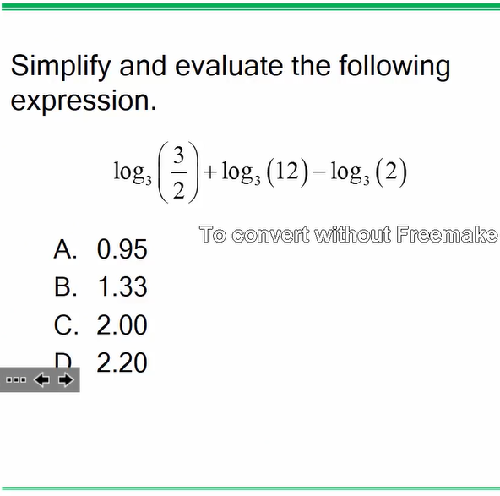
Problem 3

Slide 6
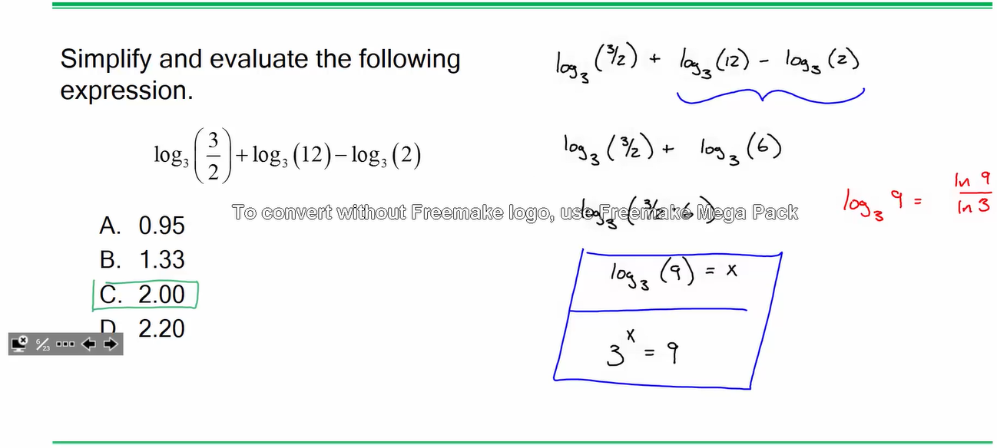
Problem 3
Page 35 & 36

Slide 7
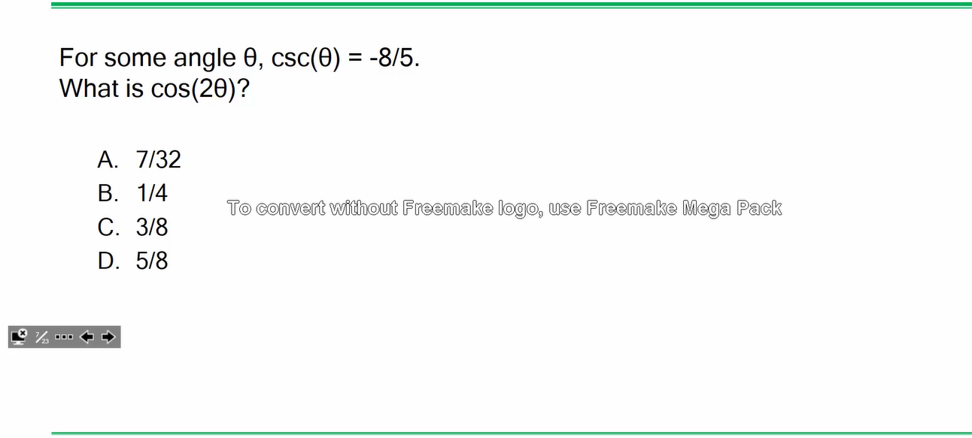
Problem 4

Slide 8
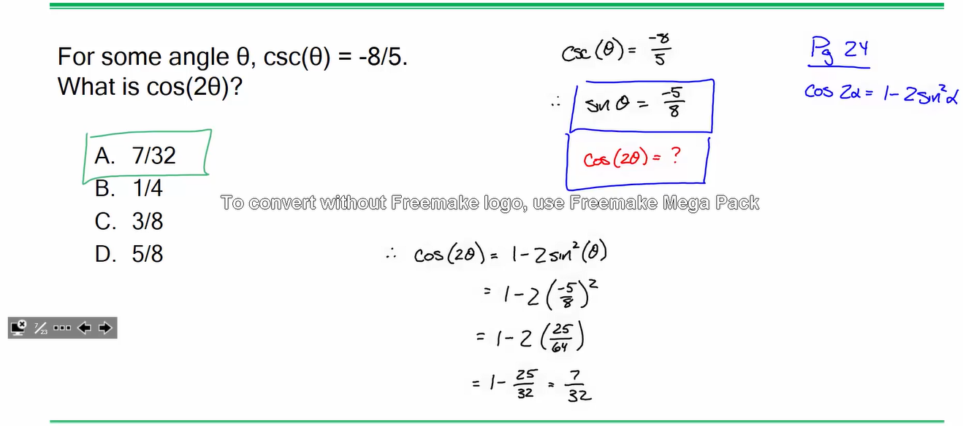
Problem 4
Page 38 - identity #13
Page 38 I- identity #3

Slide 9
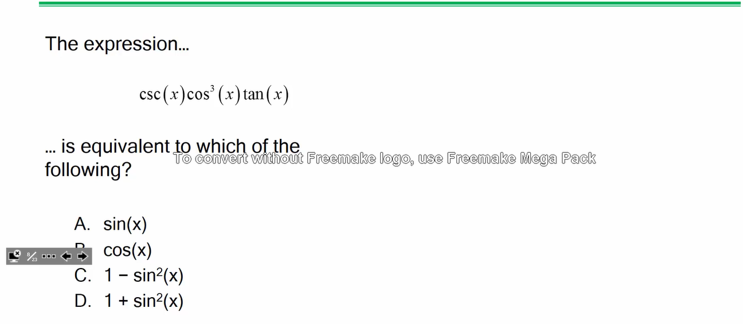
Problem 5

Slide 10
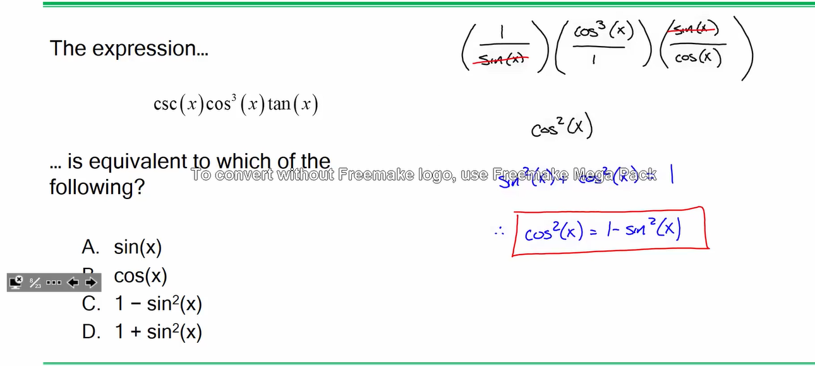
Problem 5
Page 38 – identity # 3
Page 38 – identity # 5
Page 38 – identity # 13

Slide 11
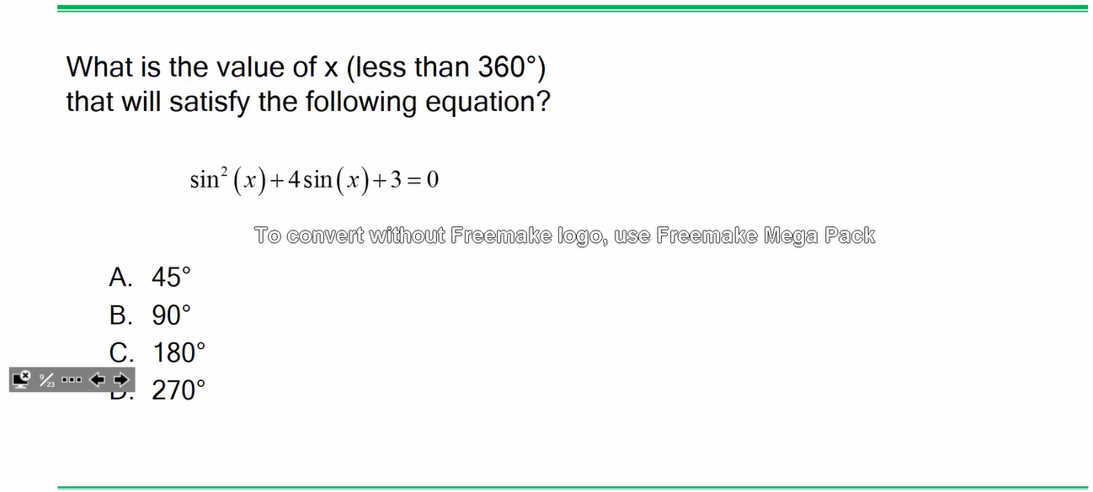
Problem 6

Slide 12
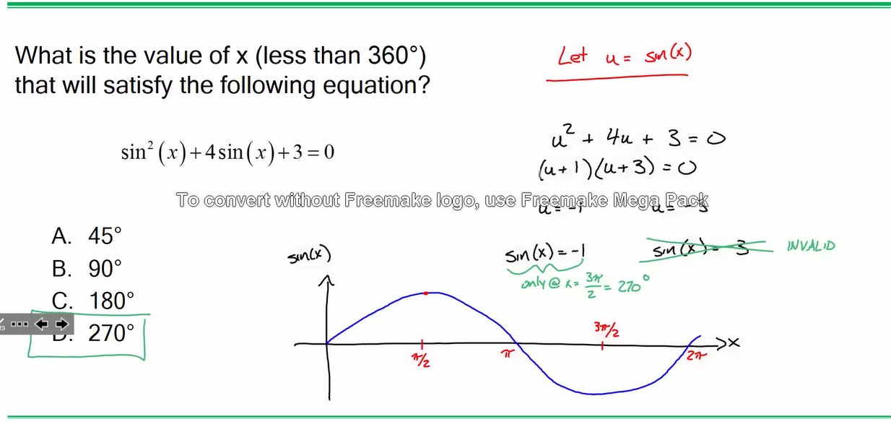
Problem 6

Slide 13
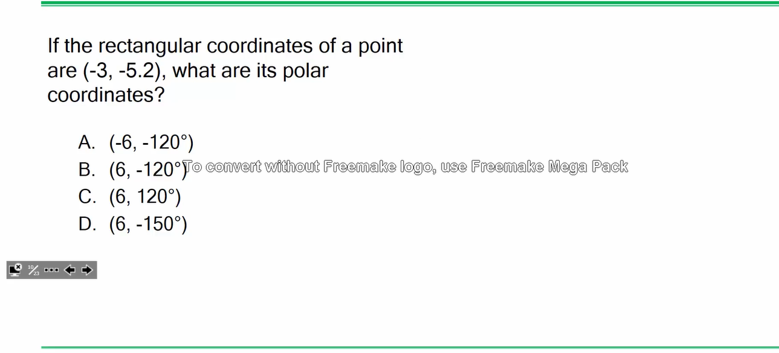
Problem 7

Slide 14
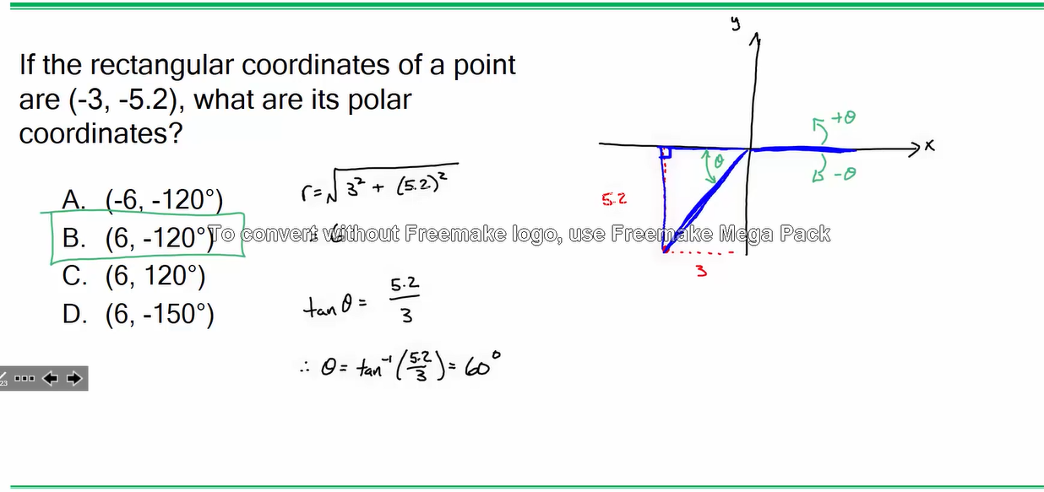
Problem 7
Page 36 - Eqn #2
Page 36 - Eqn #1

Slide 15
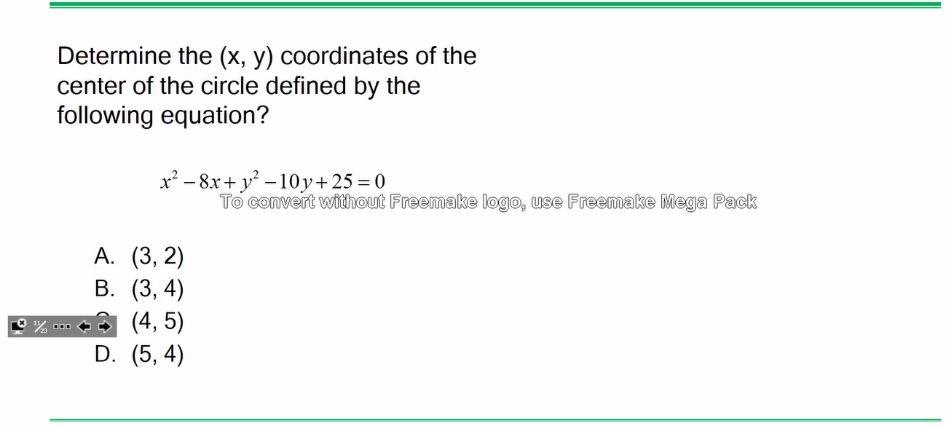
Problem 8

Slide 16
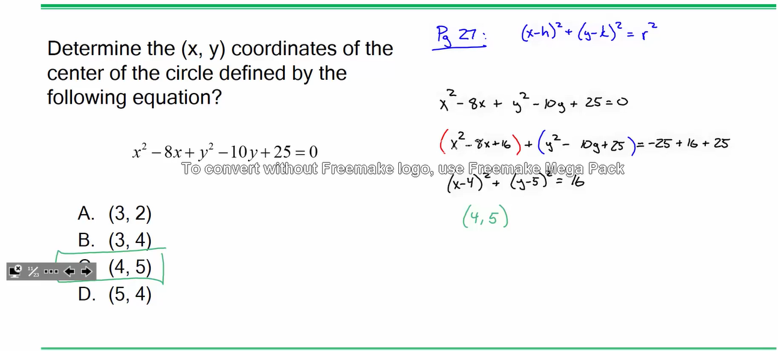
Problem 8
Page 44 – Case #4

Slide 17
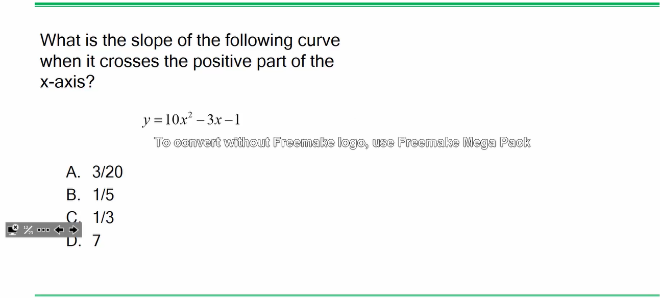
Problem 9

Slide 18
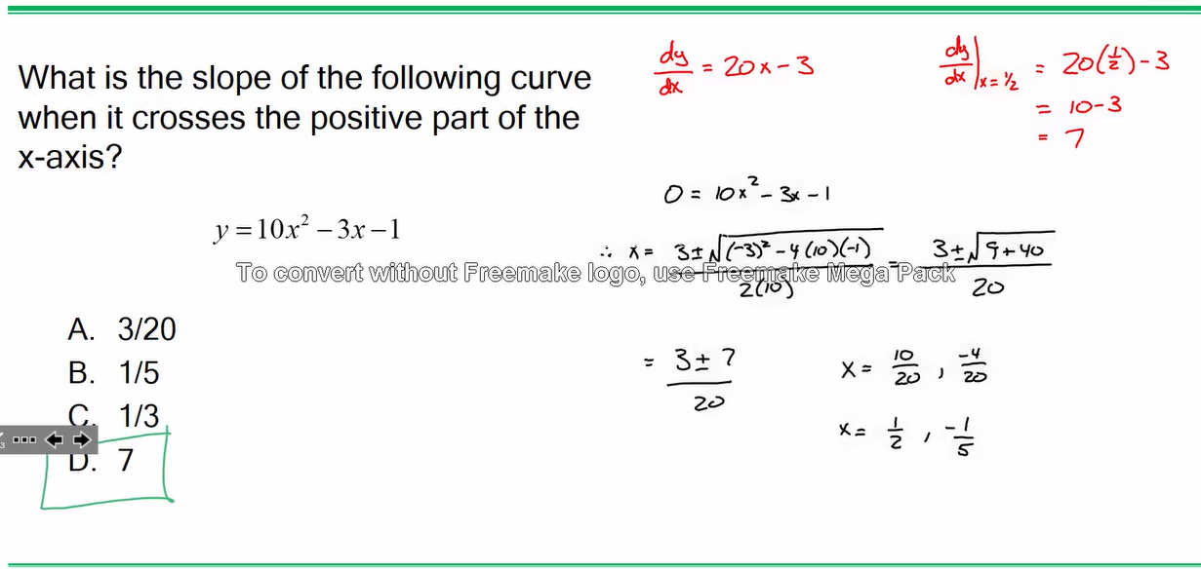
Problem 9
Page 45 – Test for a Maximum
Roots of the Quadratic Eqn - Page 35
-1/5 is ruled out since it’s NOT the positive part of the x axis

Slide 19
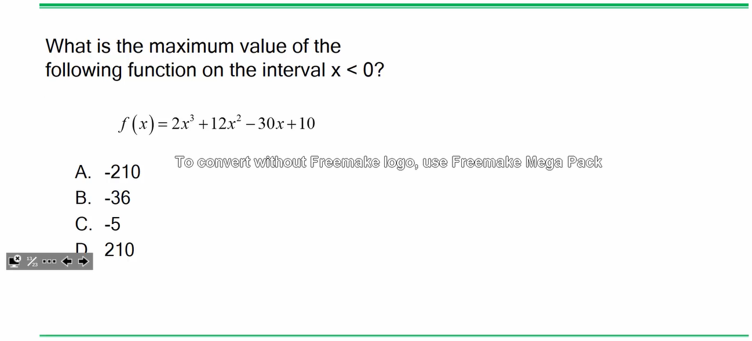
Problem 10

Slide 20
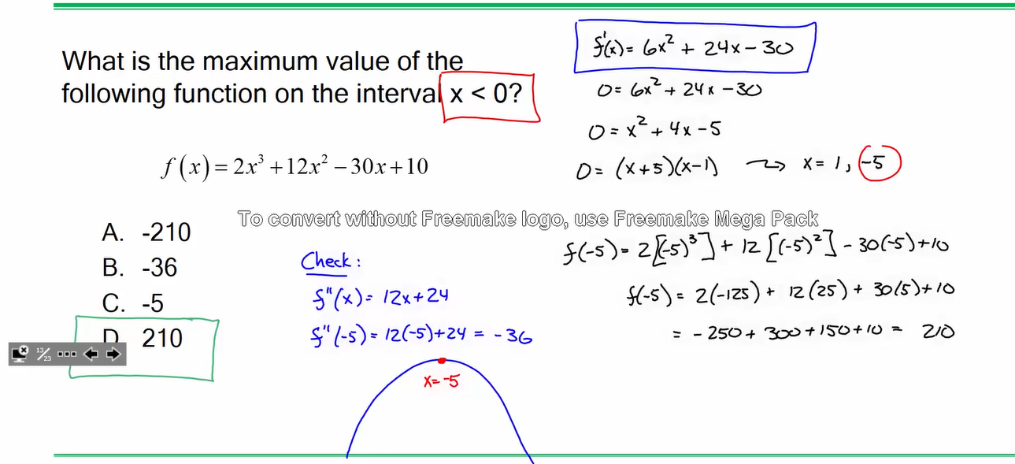
Problem 10
Page 45 – Test for a Maximum

Slide 21
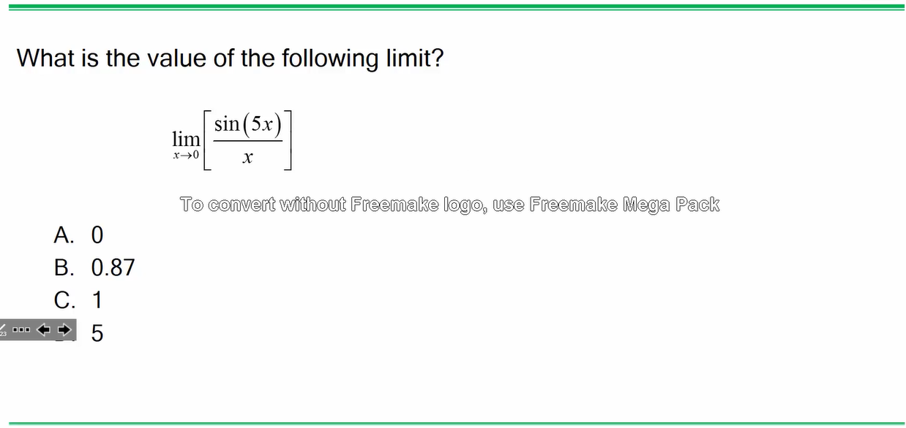
Problem 11

Slide 22
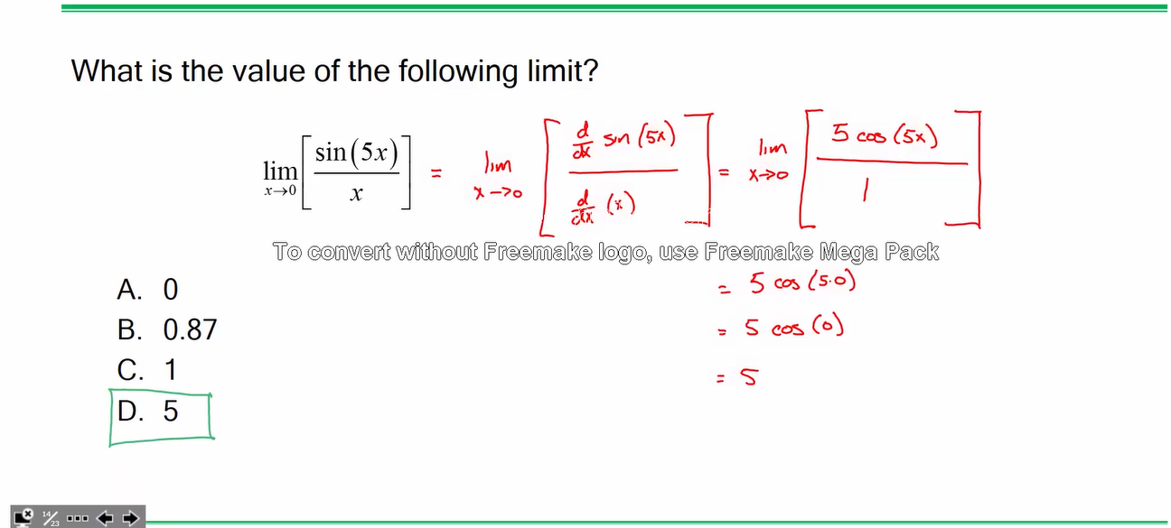
Problem 11
Page 47 L’Hopital’s rule

Slide 23
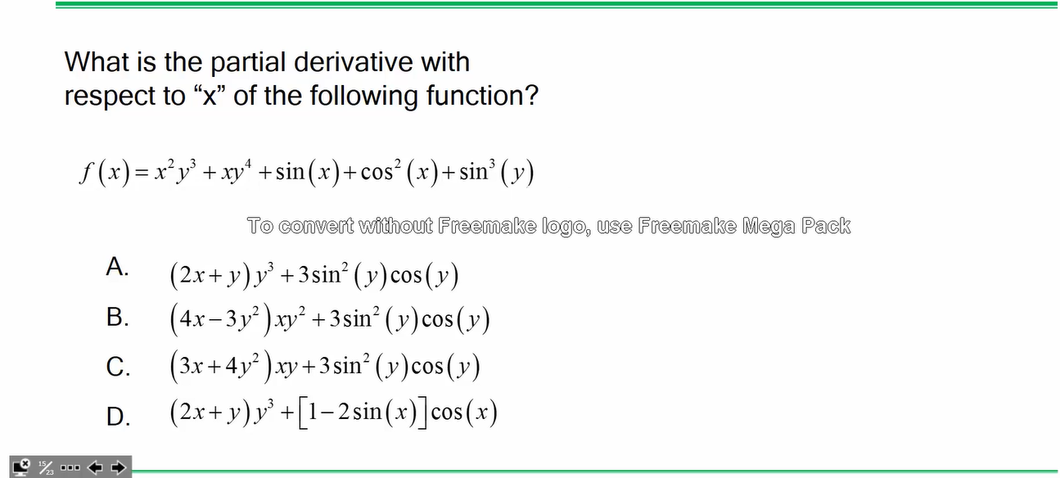
Problem 12

Slide 24
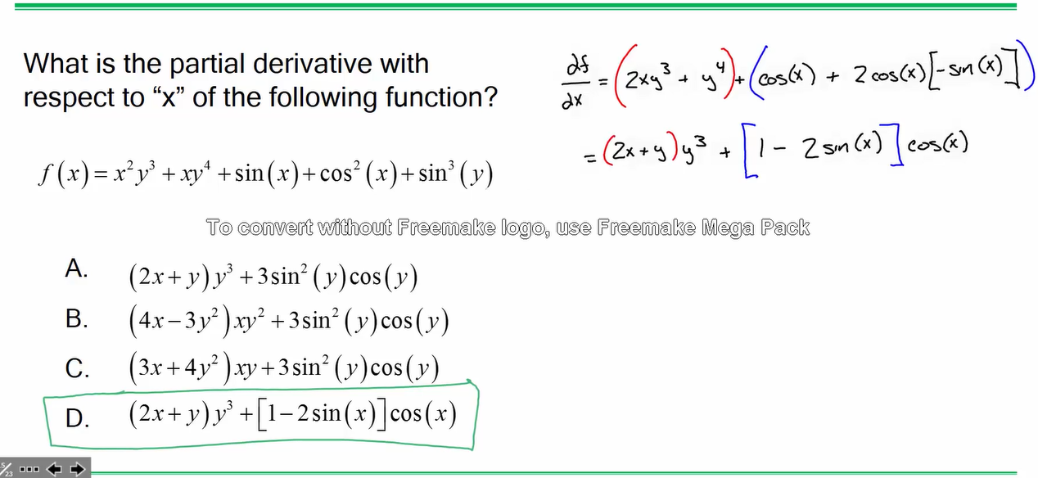
Problem 12
Page 48 #16

Slide 25
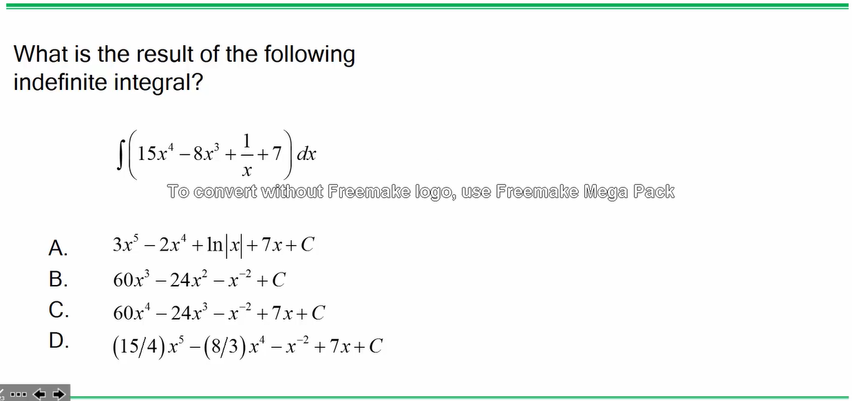
Problem 13

Slide 26
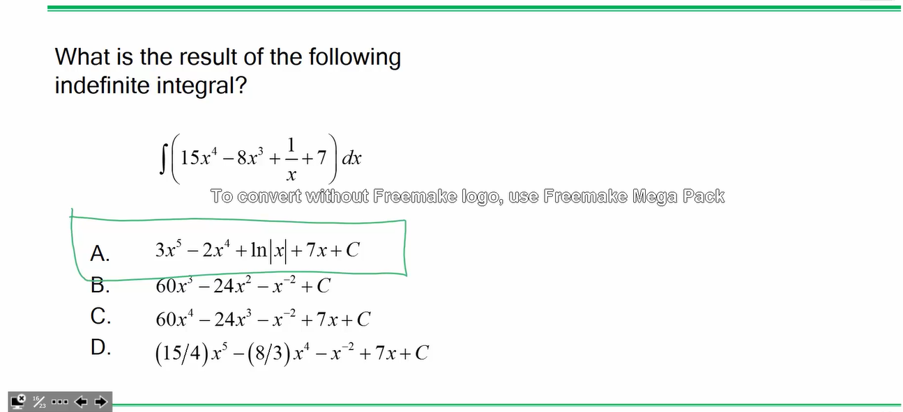
Problem 13
Page 49 #7 logarithms

Slide 27
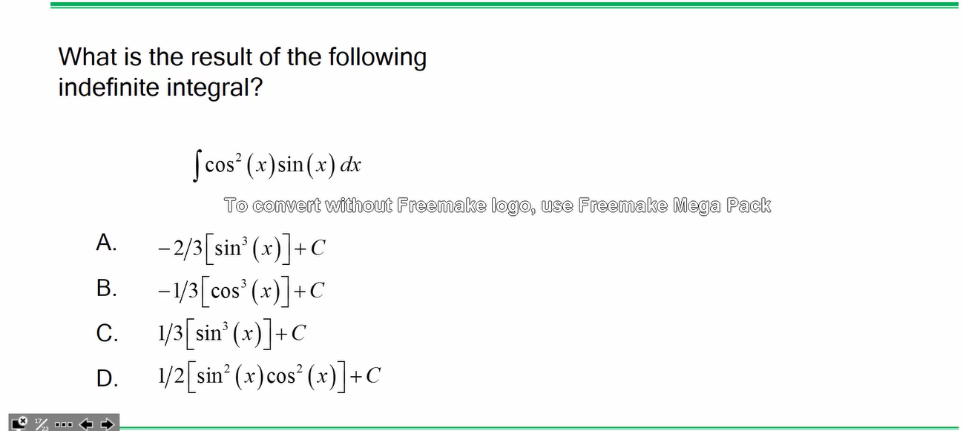
Problem 14

Slide 28
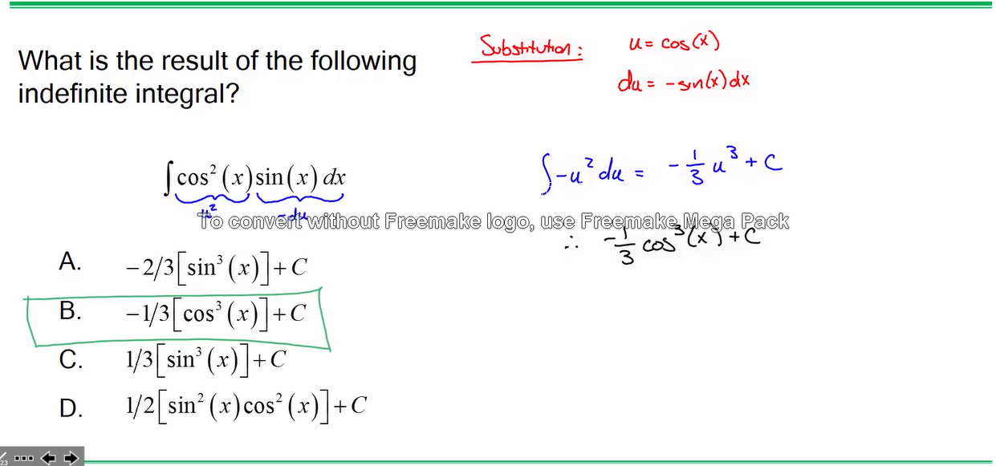
Problem 14
Derivative - Page 48 - #17

Slide 29
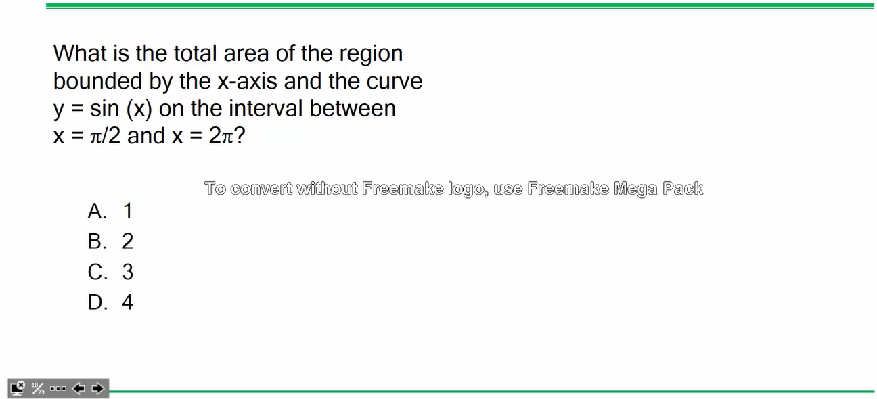
Problem 15

Slide 30
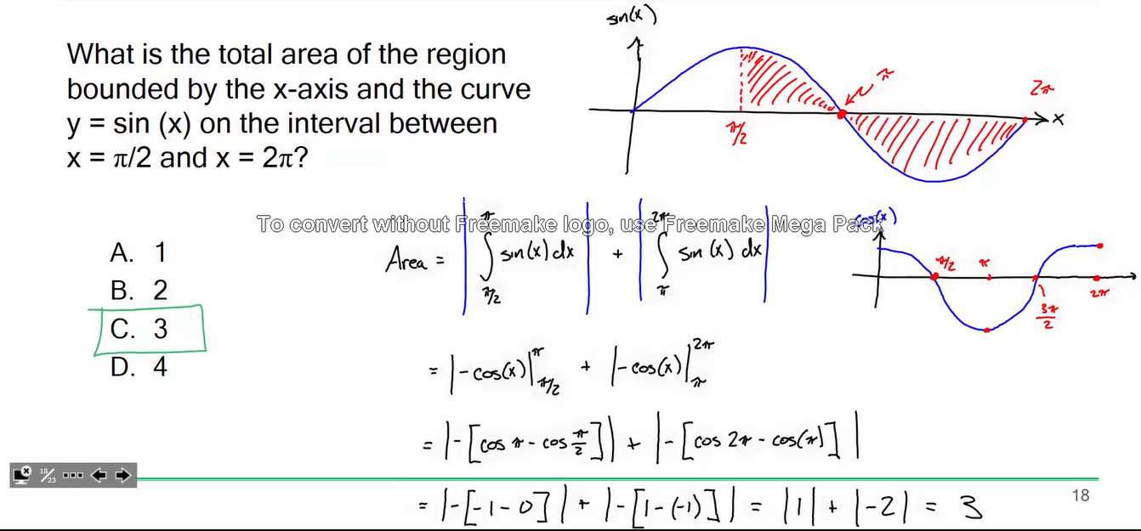
Problem 15

Slide 31
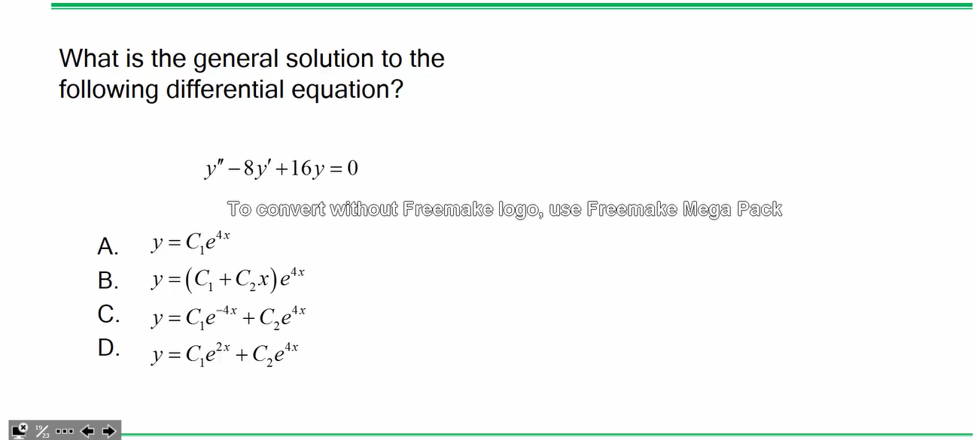
Problem 16

Slide 32
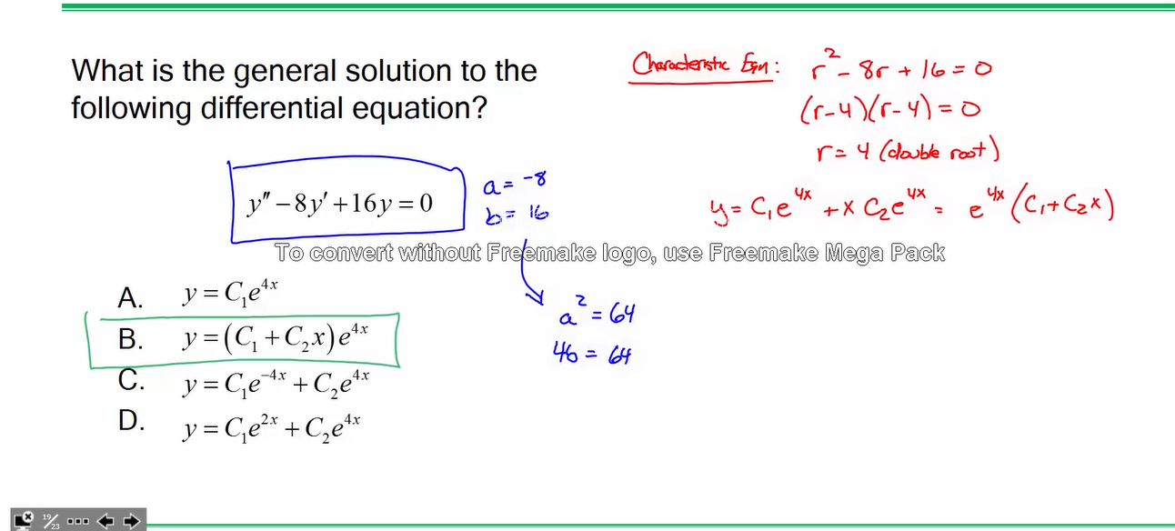
Problem 16
Page 52 – critically damped

Slide 33
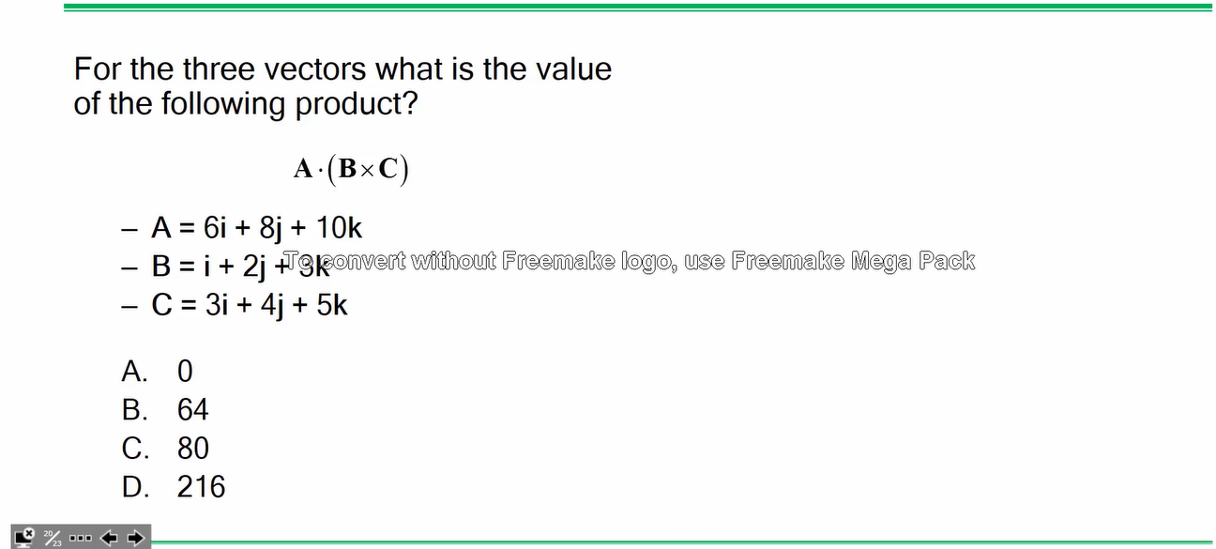
Problem 17

Slide 34
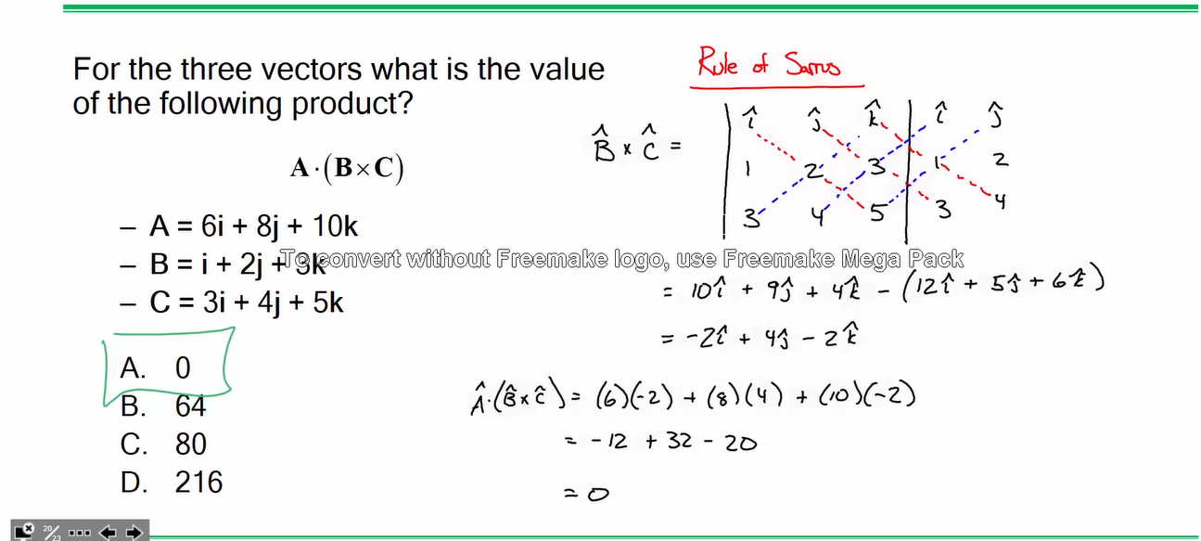
Problem 17
Page 59 – cross product
Page 59 – dot product

Slide 35
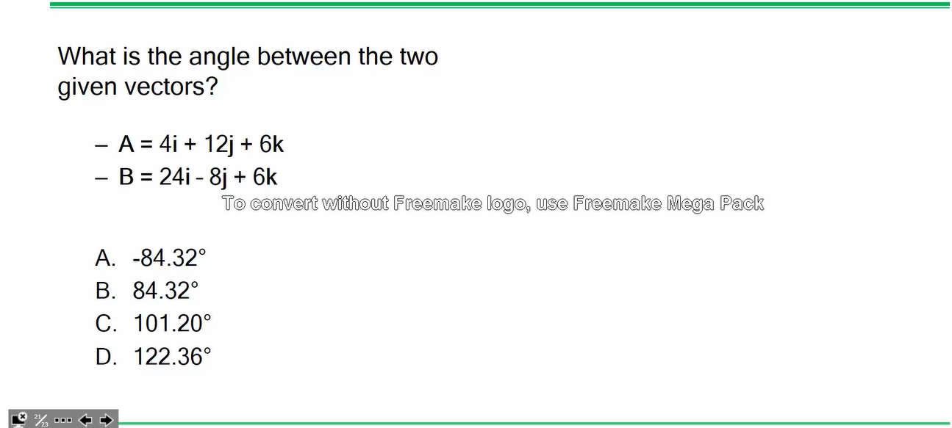
Problem 18

Slide 36
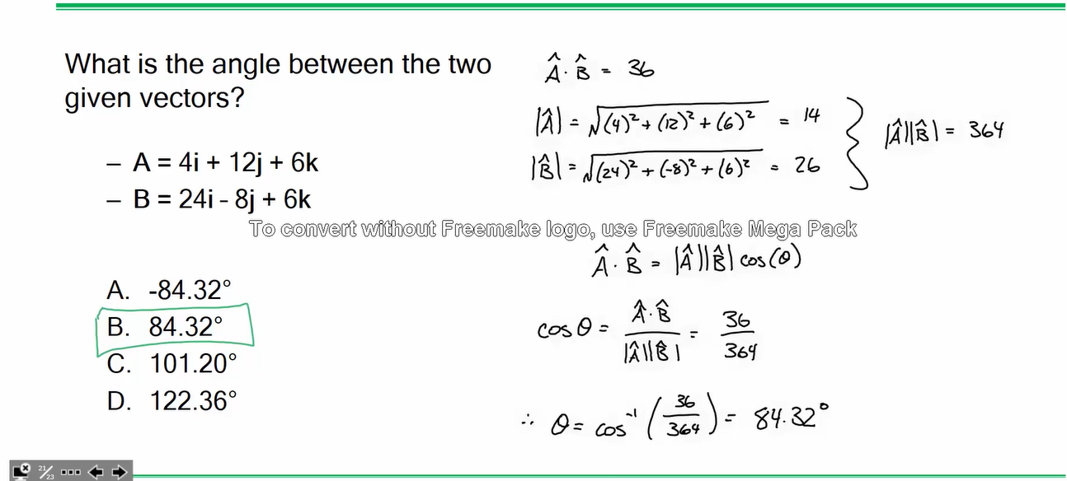
Problem 18
Pythagorean Theorem in three dimensions
Page 59 – Right-Hand Rule

Slide 37
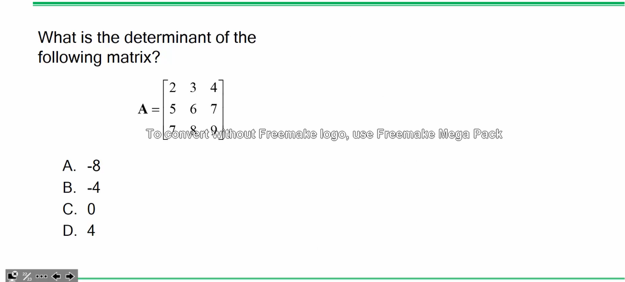
Problem 19

Slide 38
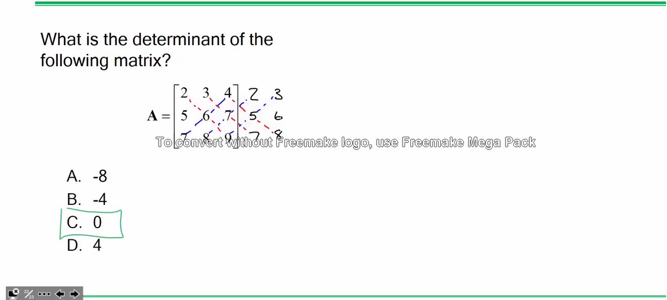
Problem 19
Page 58
Page 58 - 3rd order determinant
Rule of Sarrus

Slide 39
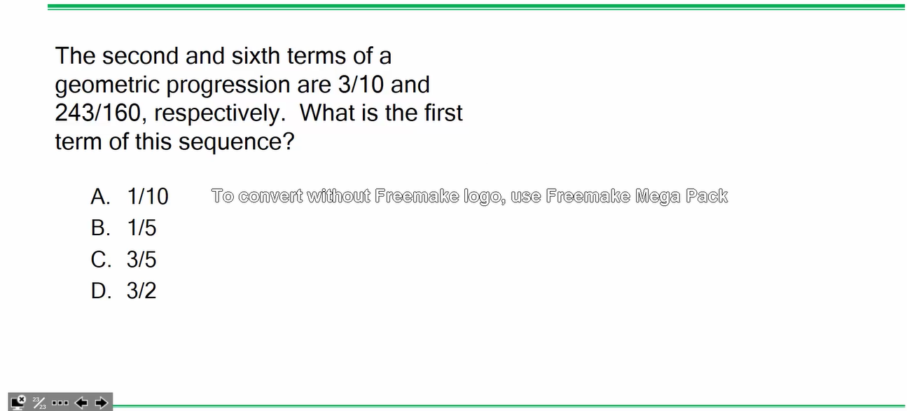
Problem 20

Slide 40
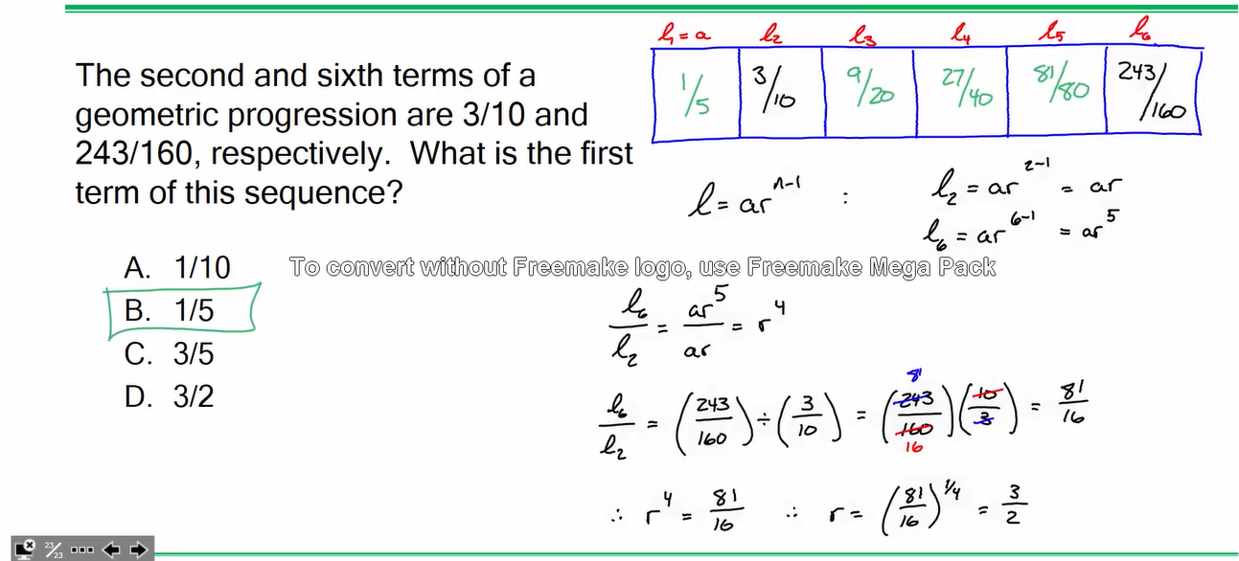
Problem 20
Page 50 – Geometric Progression Eqn #5

