Slide 1
Ethics and Professional Practice
FE/EIT Exam Review Course
29 December 2020

Slide 2
Eligibility
What is a “Professional”?
Model Rules / Model Law
Obligation to the Public
Obligation to Employers and Clients
Obligation to other Licensees
Application of Code
Intellectual Property
Patents
Trademarks
Copyrights
Trade Secrets
Societal Considerations
Safety
Agenda

Slide 3
To be eligible for licensure as a professional engineer or professional surveyor, an individual must meet all the following requirements:
Be of good character and reputation (Ongoing)
Satisfy the education criteria set forth by the board
Satisfy the experience criteria set forth by the board
Pass the applicable examinations set forth by the board
Submit five references acceptable to the board
Model Law §130.10 – General Requirements for Licensure
Eligibility for Licensure

Slide 4
Different than an “occupation”
Specialized Knowledge
Extensive training (4 years of school, 4 years of experience, 2 exams)
Privileges
Self-regulating
Independent
Responsibilities
Ethical standards
Public trust
Professions
Professional skills are important to the well-being of society.
FE Handbook 10.4, 1 July 2024

Slide 5
Model Rules §240.15 – Rules of Professional Conduct
Model Law §110.20 – Definitions
Model Law §130.10 – General Requirements for Licensure
Model Law §150.10 – Grounds for Disciplinary Action – Licensees and Interns
Model Law §150.30 – Grounds for Disciplinary Action – Unlicensed Individuals
Model Law §160.10 – General Requirements for Certificates of Authorization
Model Law §160.70 – Grounds for Disciplinary Action – Firms Holding a Certificate of Authorization
Model Law §170.30 – Exemption Clause
Model Rules / Model Law

Slide 6
Safeguard the health, safety, and welfare of the public.
Only seal documents that are deemed safe
See Something, Say Something
An unsafe condition exists
Violations of rules/law
Stick to the field(s) in which you have specialized knowledge
Don’t work with unethical entities
Obligation to the Public

Slide 7
Stick to the field(s) in which you have specialized knowledge
Only seal documents that you have directly supervised
Do not accept bribes or kickbacks
Avoid and disclose conflicts of interest
Public/governmental positions
Confidentiality
Obligation to Employers and Clients

Slide 8
Do not misrepresent yourself
Do not offer bribes or kickbacks
Do not publicly criticize other licensees
Work with the individual
Work through the state board
Only endorse those you’ve worked with for licensure
Obligation to Other Licensees

Slide 9
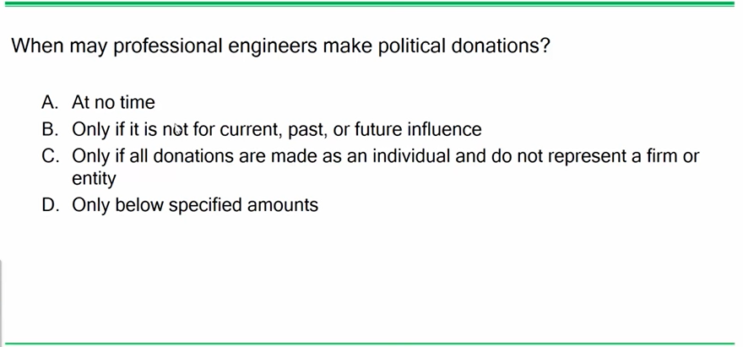
Check on Learning
Problem 1

Slide 10
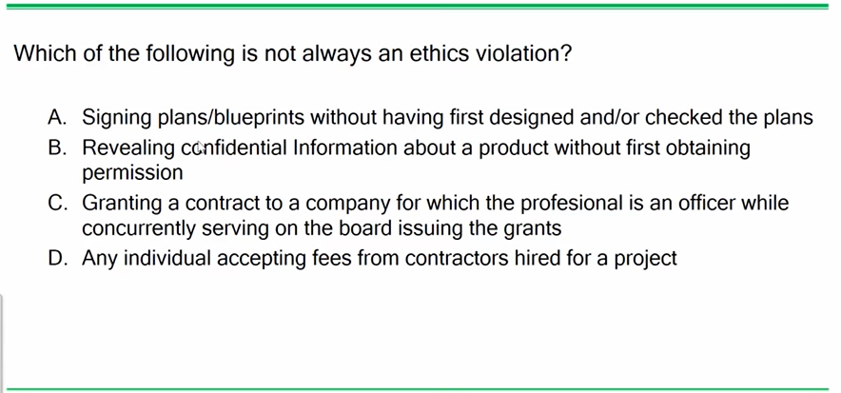
Check on Learning
Problem 2

Slide 11
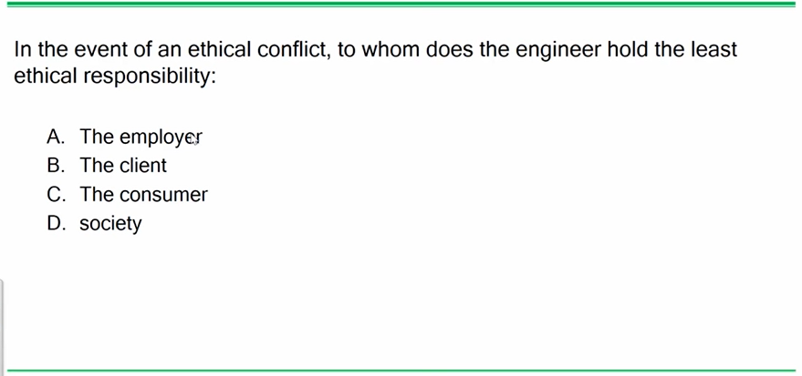
Check on Learning
Problem 3

Slide 12
Code is not a design document
Codes exist to ensure the safe construction and use of buildings, etc.
Generally, codes do not apply to manufacturing
Application of Code

Slide 13
Patents – Grants property rights to the inventor
Generally, lasts for 20 years
Only applicable in the US
Types
Utility
Design
Plant
Intellectual Property

Slide 14
Trademarks
A word, name, symbol or device to indicate the source and distinguish goods from others.
Protects only the trademark, not the good itself.
Copyrights
Protects authors of “original works of authorship” both published and unpublished.
Owner may reproduce and distribute the work to the public.
Intellectual Property

Slide 15
Trade Secrets
A trade secret applies to a formula, pattern, compilation, program, device, method, technique, or process. To meet the most common definition of a trade secret, it must be used in business and give an opportunity to obtain an economic advantage over competitors who do not know or use it. Trade secrets offer little protection without a written agreement between the involved parties.
United States Patent and Trademark Office, https://www.uspto.gov/patents-getting-started/general-information-concerning-patents#headings-2.
Intellectual Property

Slide 16
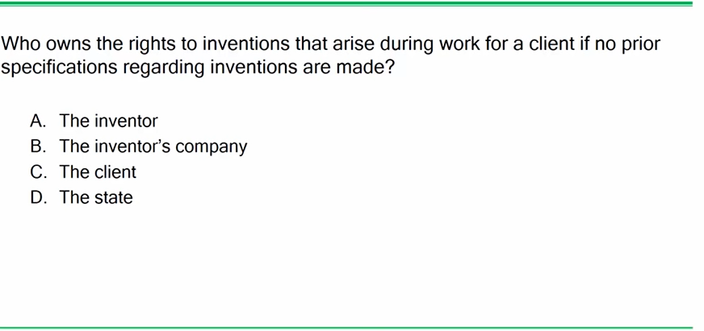
Check on Learning
Problem 4

Slide 17
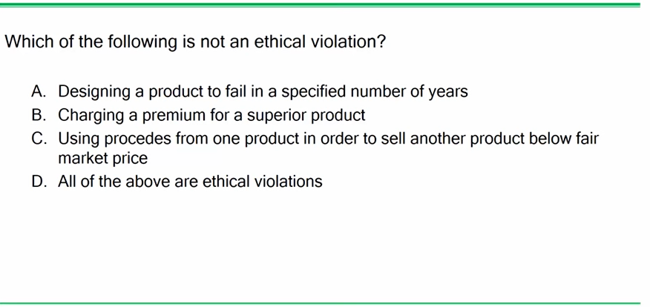
Check on Learning
Problem 5

Slide 18
Sustainability
Quality of Life
Public Health
Renewable Resources
Life-Cycle Analysis
Product sourcing
Disposal
Emissions
Societal Considerations

Slide 19
Risk = Hazard x Probability/Exposure
Globally Harmonized System (GHS) and Safety Data Sheets (SDS)
OSHA
Exposure Limits: chemicals, noise, radiation, etc.
Safety

Slide 20
Check on Learning
Problem 9
9. A licensee’s Obligation to Employer and Clients extends to which of the following:
o A. Licensees shall be cognizant that their first and foremost responsibility is to safeguard the health, safety, and welfare of the public when performing services for clients and employers.
o B. A Licensees may use confidential information received in the course of their assignments as a means of making personal profit without the consent of the party from whom the information was obtained.
o C. Licensees shall undertake assignments only when qualified by education or experience in the specific technical fields of engineering or surveying involved.
o D. Licensees shall not injure or attempt to injure, maliciously or falsely, directly or indirectly, the professional reputation, prospects, practice, or employment of other licensees, nor indiscriminately criticize other licensees’ work.
9. Refer to the Ethics chapter of the FE Reference Handbook & the FE Civil Practice Exam.
THE CORRECT ANSWER IS: C
Option A: Not true. Section A.1 in the Rules of Professional Conduct refers to a Licensee’s Obligation to the Public
Option B: Not true. Section B.9 in the Rules of Professional Conduct states: Licensees shall not use confidential information received in the course of their assignments as a means of making personal profit without the consent of the party from whom the information was obtained.
Option C: True. Section B.1 in the Rules of Professional Conduct states: Licensees shall undertake assignments only when qualified by education or experience in the specific technical fields of engineering or surveying involved.
Option D: Not true. Section C.1 in the Rules of Professional Conduct refers to a Licensee’s Obligation to Other Licensees

Slide 21
Check on Learning
Problem 10
10. An engineer testifying as an expert witness in a product liability case should:
o A. answer as briefly as possible only those questions posed by the attorneys
o B. provide an evaluation of the character of the defendant
o C. provide a complete and objective analysis within his or her area of competence
o D. provide information on the professional background of the defendant
10. Refer to the NCEES Rules of Professional Conduct in the Ethics chapter of the FE Reference
Handbook & the FE Civil Practice Exam.
Licensees may express a professional opinion publicly only when it is founded on adequate
knowledge of the facts and a competent evaluation of the subject matter.
THE CORRECT ANSWER IS: C

Slide 22
Check on Learning
Problem 11
11. As a professional engineer originally licensed 30 years ago, you are asked to evaluate a newly
developed computerized control system for a public transportation system. The owner requires a
currently licensed engineer to evaluate the system. You may accept this project if:
Select all that apply.
□ A. you are competent in the area of computerized control systems
□ B. your professional engineering license has lapsed, but you have two FE interns working for you
□ C. you took a transportation course in college
□ D. you have regularly attended meetings of a professional engineering society
□ E. you have another licensed engineer work for you who is competent in this area, and he or she will conduct all related work and stamp the related design
11. Refer to the NCEES Rules of Professional Conduct, Section B, in the Ethics chapter of the FE
Reference Handbook & the FE Civil Practice Exam.
THE CORRECT ANSWERS ARE: A, E

Slide 23
Check on Learning
Problem 13
13. A professional engineer was originally licensed 30 years ago and is still currently licensed. The
engineer’s employer asks the engineer to evaluate a newly developed computerized control system
for public transportation. The employer requires that a currently licensed engineer evaluate the
system. The engineer may accept the assignment under which conditions?
o A. The engineer is competent in modern control systems.
o B. The engineer supervises two recent graduates who have passed the FE exam.
o C. The engineer studied transportation systems in college.
o D. The engineer has regularly attended meetings of a professional engineering society.
13. Refer to the Ethics chapter of the FE Reference Handbook & the FE Mechanical Practice Exam.
The Rules of Professional Conduct, Section B.1, states that licensees may undertake assignments
only in the fields in which they are qualified by education or experience.
THE CORRECT ANSWER IS: A

Slide 24
Problem 14
Check on Learning
14. An engineering firm has overall design responsibility for a large multifaceted construction project. The state in which the work is being conducted requires civil, structural, environmental, electrical, and mechanical engineering plans to be prepared and stamped by a professional engineer. Which of the following statements are true? Select all that apply.
14. Refer to the Rules of Professional Conduct, Section B.1, in the Ethics chapter of the FE Reference Handbook & the FE Mechanical Practice Exam.
A. Responsibility for the coordination of the entire project can be accepted by the firm’s senior engineer, who is responsible for signing and sealing all the submitted plans.
Option A: Not true. Licensees may accept assignments and assume responsibility for coordination of an entire project, provided that each technical segment is signed and sealed by the licensee responsible for preparation of that technical segment.
B. Responsibility for coordination of the entire project can be accepted by the firm’s senior engineer if each technical submittal is signe dand sealed by the qualified engineer assigned to that segment.
Option B: True: See above.
C. The foremost responsibility of the professional engineer is to safeguard the health, safety, and welfare of the public when performing services for clients and employers.
Option C: True. The first respoand foremost nsibility of licensees is to safeguard the health, safety, and welfare of the public when performing services for clients and employers.
D. The technical competence of the professional engineers on the project is not as important as their responsibility to disclose to their employers or clients all known or potential conflicts of interest or other circumstances that could influence or appear to influence their judgment or the quality of their professional service or engagement.
Option D: Not true. Licensees must disclose to their employers or clients all known or potential conflicts of interest or other circumstances that could influence or appear to influence their judgment or the quality of their professional service or engagement.
E. Licensing laws and rules governing engineering professional practice may vary in each of the jurisdictions in which a licensee practices.
Option E: True. Licensees must comply with the licensing laws and rules governing their professional practice in each of the jurisdictions in which they practice.

Slide 25
Check on Learning
Problem 15
15. You and your design group are competing for a multidisciplinary concept project. Your firm is the lead group in the design professional consortium formed to compete for the project. Your consortium has been selected as the first to enter fee negotiations with the project owner. During the negotiations, the amount you have to cut from your fee to be awarded the contract will require dropping one of the consortium members whose staff has special capabilities not available from the staff of the remaining consortium members. Can your remaining consortium ethically accept the contract?
o A. No, because an engineer may not accept a contract to coordinate a project with other professional firms providing capabilities and services that must be provided by hired consultants.
o B. Yes, if your remaining consortium members hire a few new lower-cost employees to do the special work that would have been provided by the consortium member that has been dropped.
o C. No, not if the owner is left with the impression that the consortium is still fully qualified to perform all the required tasks.
o D. Yes, if in accepting an assignment to coordinate the project, a single person will sign and seal all the documents for the entire work of the consortium.
15. Refer to the NCEES Rules of Professional Conduct, Sections B and C, in the Ethics chapter of
the FE Reference Handbook & the FE Industrial Practice Exam.
THE CORRECT ANSWER IS: A

Slide 26
Check on Learning
Problem 16
16. You are a student and have an on-site job interview with Company A. Just before you fly to the interview, you get a call from Company B asking you to come for an on-site interview at their offices in the same city. When you inform them of your interview with Company A, they suggest you stop in after that. Company A has already paid for your airfare and, at the conclusion of your interview with them, issues you reimbursement forms for the balance of your trip expenses with instructions to file for all of your trip expenses. When you inform them of your added interview stop at Company B, they tell you to go ahead and charge the entire cost of the trip to Company A. You interview with Company B, and at the conclusion, they give you travel reimbursement forms with instructions to file for all of your trip expenses. When you inform them of the instructions of Company A, they tell you that the only expenses requiring receipts are airfare and hotel rooms, so you should still file for all the other expenses with them even if Company A is paying for it because students always need a little spending money. What should you do?
o A. File for travel expenses with only one firm.
o B. Do as both recruiting officers told you. It is their money and their travel policies.
o C. File for travel expenses from both firms so you receive double your expense cost.
o D. Tell all of your classmates to sign up to interview with these firms for the trips.
16. Refer to the NCEES Rules of Professional Conduct, Section B, in the Ethics and Professional
Practice chapter of the FE Reference Handbook & the FE Electrical Practice Exam.
THE CORRECT ANSWER IS: A

