Slide 1
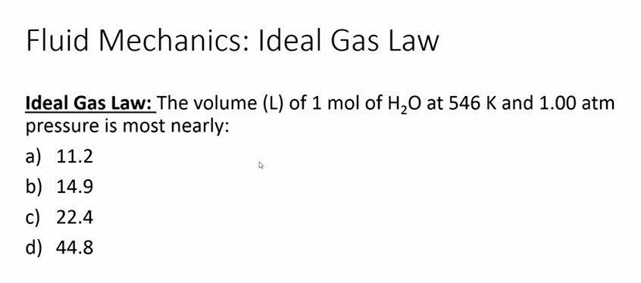
Problem 1

Slide 2
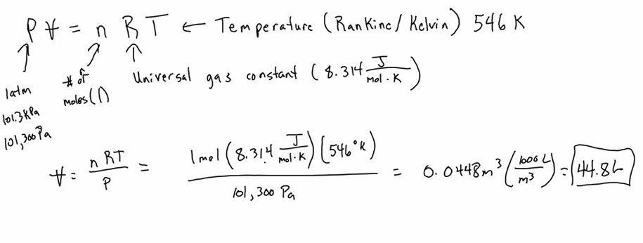



Problem 1
From Fundamental Constants on page 2 of FE Handbook:
8.314 kPa·m3/(kmol·K) = 8,314 J/(kmol·K = 0.08206 L·atm/(mole·K)
ALTERNATIVE METHOD
From Fundamental Constants on page 2 of FE Handbook:
molar volume (ideal gas), T = 273.15 K, p = 101.3 kPa Vm 22,414 L/kmol
$$\frac{P_{1}V_{1}}{T_{1}}=\frac{P_{2}V_{2}}{T_{2}}$$
$$\frac{T_{2}V_{1}}{T_{1}}=V_{2}$$
If $T_{1}=273K \&\text{If} T_{2}=546K, then V_{2}$ = 2 x 22.414 L=44.8L

Slide 3
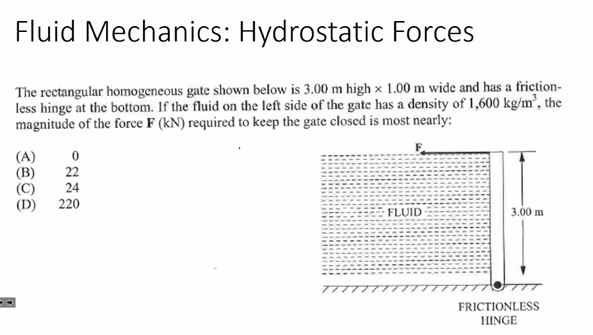
Problem 2

Slide 4
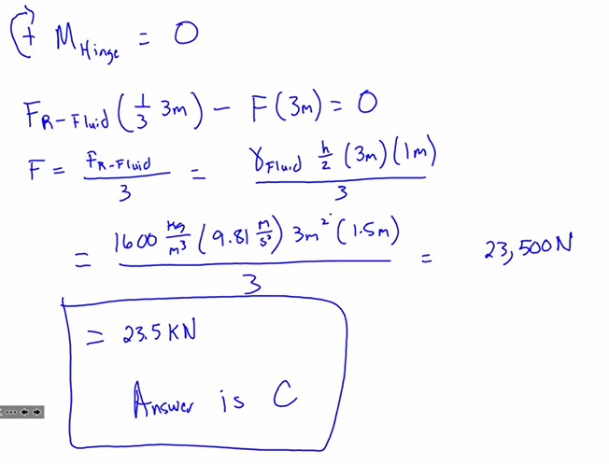



Problem 2
newton (N) 1 kg•m/s2

Slide 5
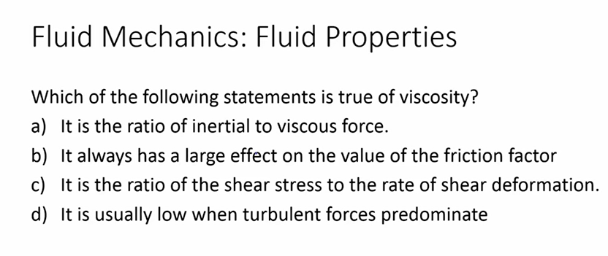
Problem 3

Slide 6
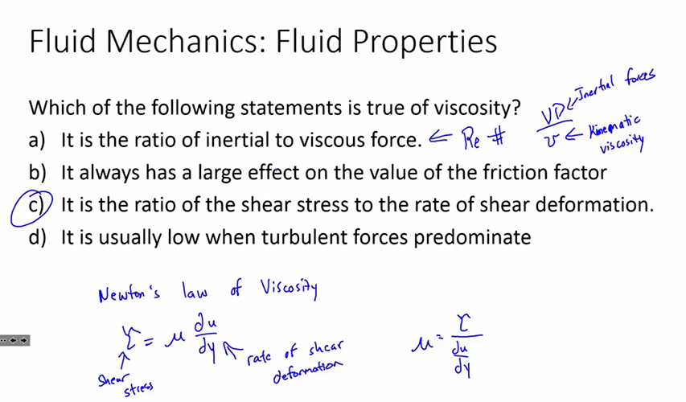
Problem 3
τ = μ(dv/dy) on page 177 of FE Handbook

Slide 7
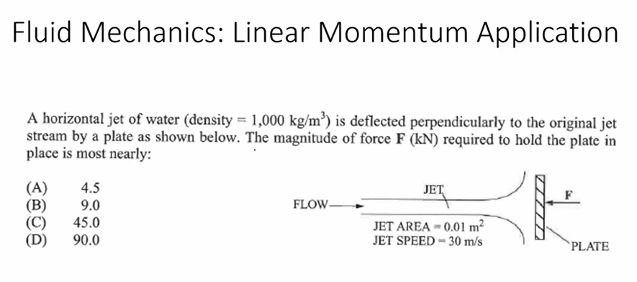
Problem 4

Slide 8
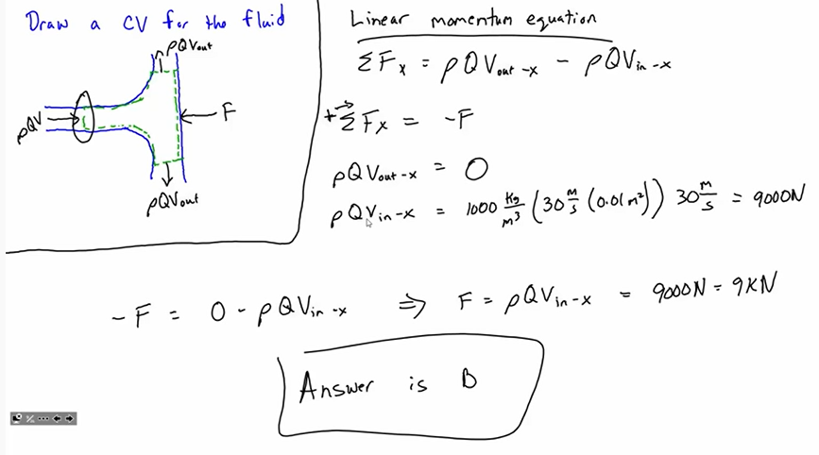
Problem 4

Slide 9
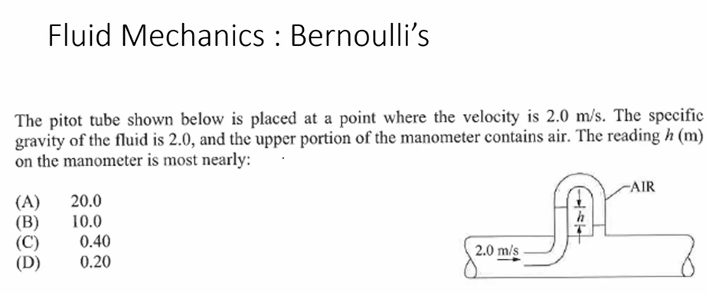
Problem 5

Slide 10
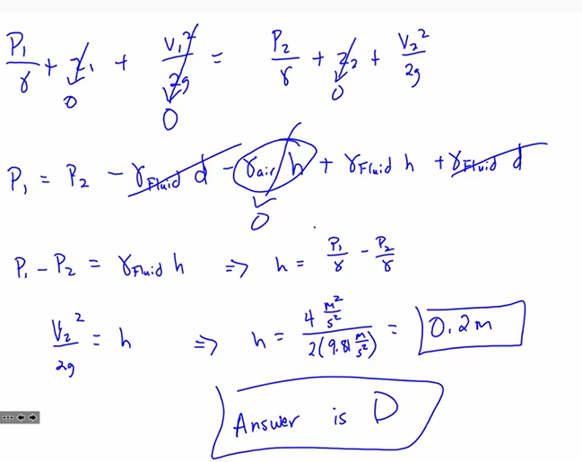
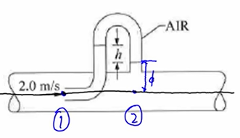
Problem 5
Page 195 of FE Handbook

Slide 11
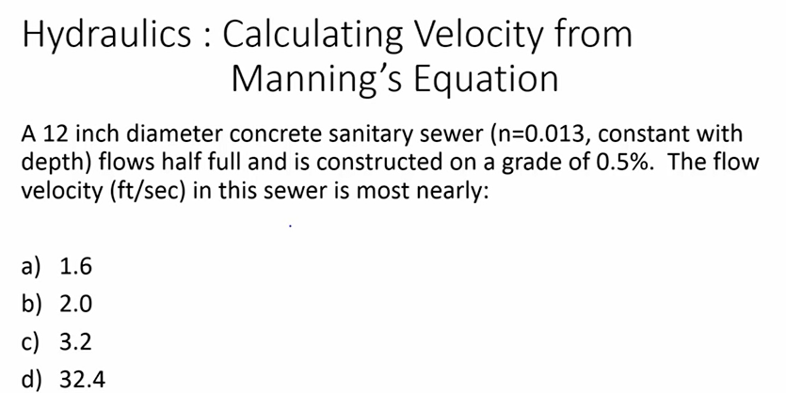
Problem 6
Page 185 of FE Handbook

Slide 12
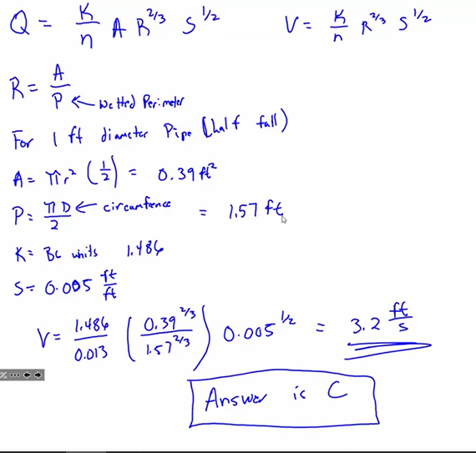
Problem 6

Slide 13
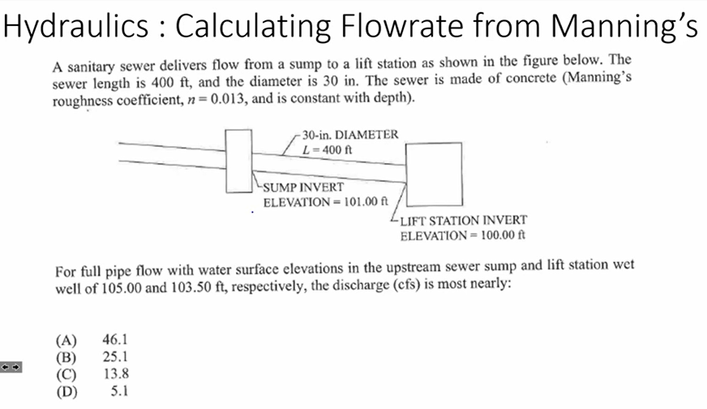
Problem 7

Slide 14
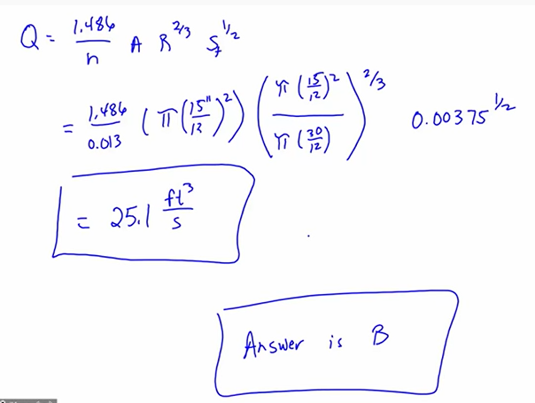
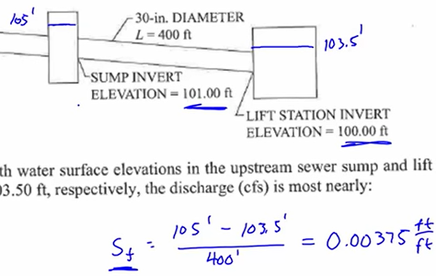
Problem 7

Slide 15
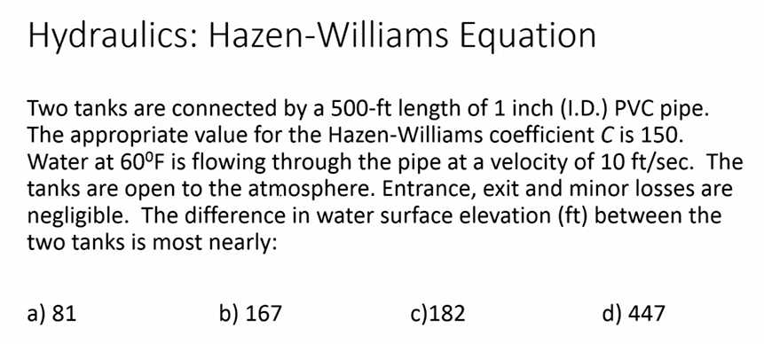
Problem 8
Page 185 of FE Handbook

Slide 16
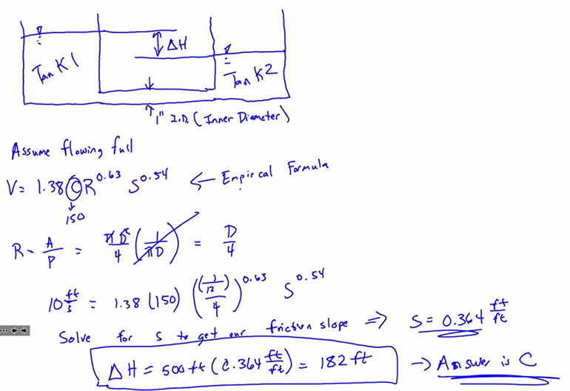
Problem 8

Slide 17
Problem 27

Slide 18
Problem 27
27. Refer to the Fluid Flow Characterization section in the Fluid Mechanics section of the FE
Reference Handbook.
Re = vD/ν = (0.52 m/s) × (1.25 cm) / (0.000001306 m2/s) (100 cm/m) = 4,977 or ~5,000
ν = kinematic viscosity, which for water at 10°C is 0.000001306 m2/s, as shown on the
Properties of Water table (SI) in the Fluid Mechanics chapter of the FE Reference Handbook.
The Reynolds number for this water flow is ~5,000, which would be considered transitional
flow.
Re < 2,100 is laminar; 2,100 < Re < 10,000 is transitional; and Re > 10,000 is turbulent.
THE CORRECT ANSWER IS: B
Page 182 of FE Handbook
Chart on page 201 of FE Handbook

Slide 19
Problem 46

Slide 20
Problem 46
46. Refer to the Characteristics of a Static Liquid section in the Fluid Mechanics chapter of the
FE Reference Handbook.
The mean pressure of the fluid acting on the gate is evaluated at the mean height, and the center of
pressure is 2/3 of the height from the top; thus, the total force of the fluid is:
and its point of application is 1.00 m above the hinge. A moment balance about the hinge gives:
THE CORRECT ANSWER IS: C

Slide 21
Problem 47
47. Four water tanks are shown with varying water heights H and varying nozzle cross-sectional
areas A0. Assume no minor losses in the discharge and a common coefficient of discharge
C = 0.6 for all the nozzles. Match the discharge velocity (ft/sec) to the correct tank.
Discharge Velocity (ft/sec)
13.6
11.8
14.3
15.2
16.7

Slide 22
Problem 47
Refer to the Orifice Discharging Freely into Atmosphere section in the Fluid Mechanics chapter
of the FE Reference Handbook.
Q = CA0(2gh)1/2
Q = VA
V = C(2gh)1/2
V A = 0.6(2 × 32.2 ft/sec2 × 8 ft)1/2 = 13.6 ft/sec
V B = 0.6(2 × 32.2 ft/sec2 × 6 ft)1/2 = 11.8 ft/sec
V C = 0.6(2 × 32.2 ft/sec2 × 10 ft)1/2 =15.2 ft/sec
V D = 0.6(2 × 32.2 ft/sec2 × 12 ft)1/2 = 16.7 ft/sec
THE CORRECT ANSWER IS SHOWN.
page 186 of FE Handbook

Slide 23
Problem 40
40. A 10-ft-wide rectangular concrete channel is to be built to convey storm water runoff. The channel
grade is 0.2%. The Manning's roughness coefficient n is 0.015. If the depth of flow is 2 ft, the
discharge (cfs) is most nearly:
o A. 110
o B. 150
o C. 250
o D. 500

Slide 24
Problem 40
Page 185 of FE Handbook
Refer to the Manning's Equation section in the Fluid Mechanics chapter of the FE Reference
Handbook.
THE CORRECT ANSWER IS: A

Slide 25
Problem 41
41. Mark the point on the system curve that shows the head and flow when the two pumps, Pumps A
and Pump B, are working in parallel in the system.

Slide 26
Problem 41
Refer to the Fluid Flow Machinery section in the Fluid Mechanics chapter of the FE Reference
Handbook.
THE CORRECT ANSWER IS SHOWN ON THE GRAPH.

Slide 27
Problem 4

Slide 28
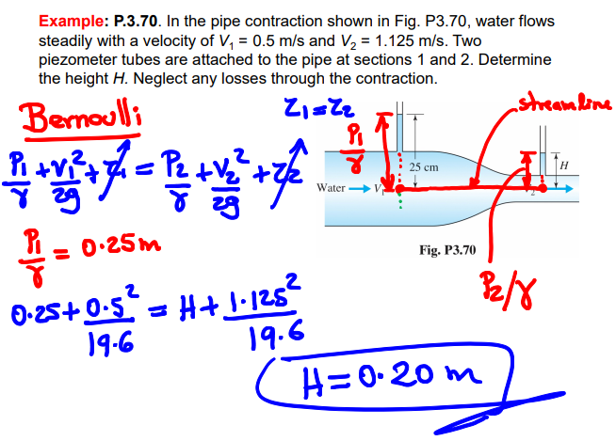
Problem 4

Slide 29
Problem 5

Slide 30
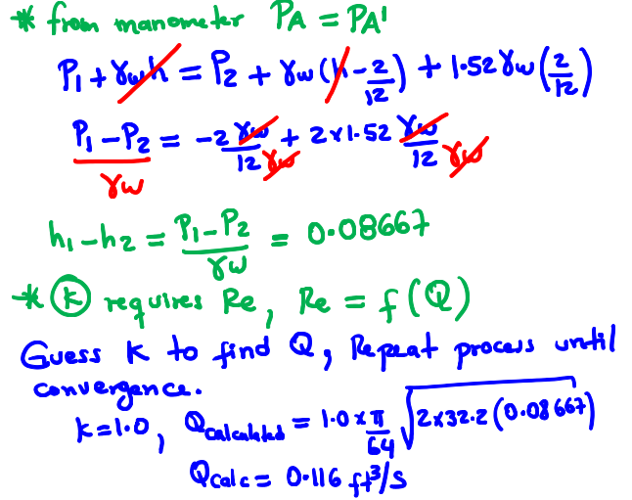
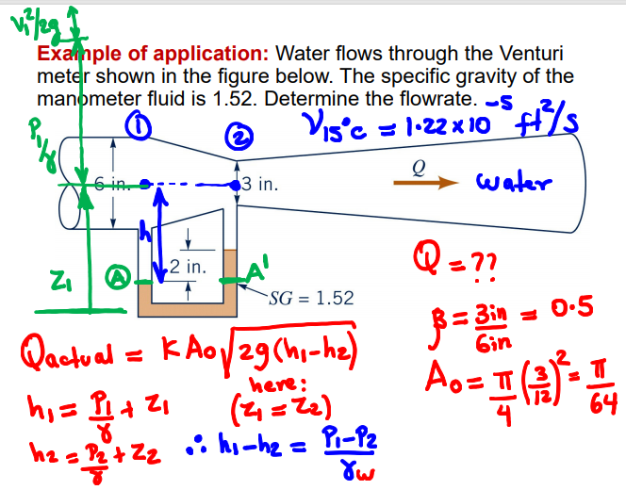
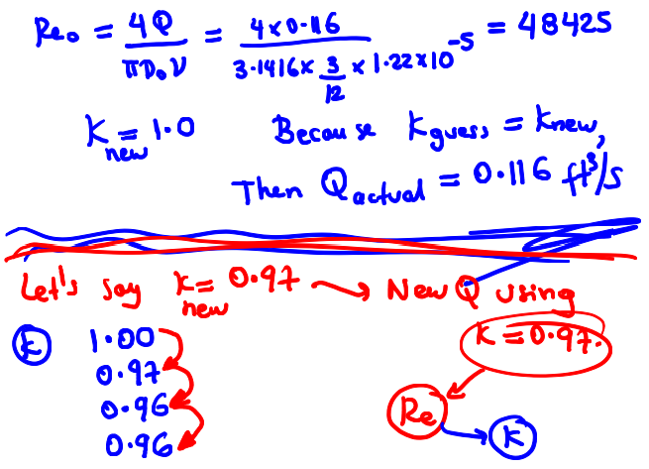
Problem 5

Slide 31
Problem 6

Slide 32
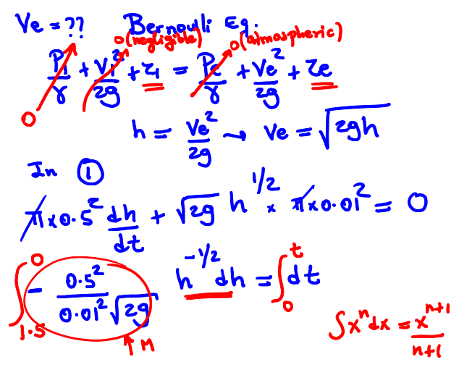
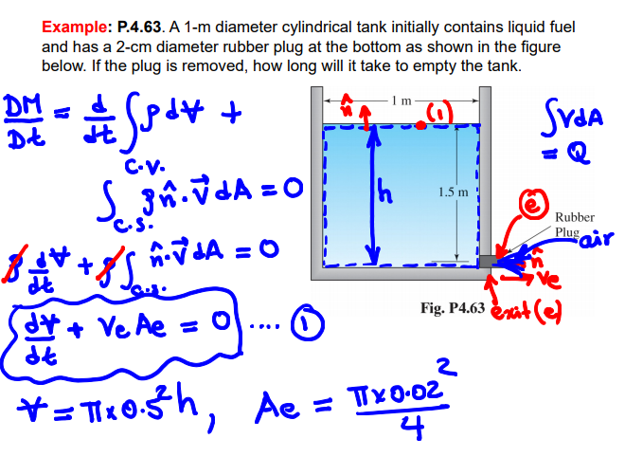
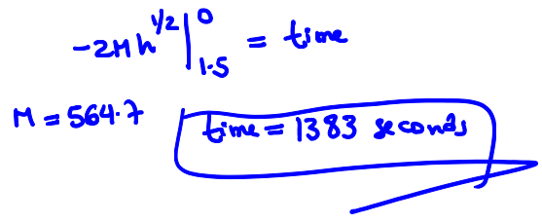
Problem 6

Slide 33
Problem 7

Slide 34
Problem 7

Slide 35
Problem 8

Slide 36
Problem 8

Slide 37
Problem 9

Slide 38
Problem 9

Slide 39
Problem 10

Slide 40
Problem 10

