Slide 1
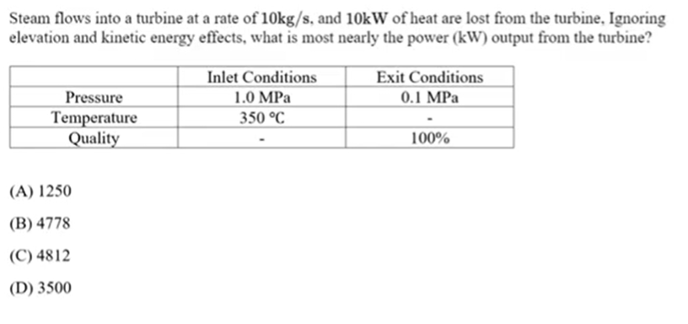
Problem 1

Slide 2
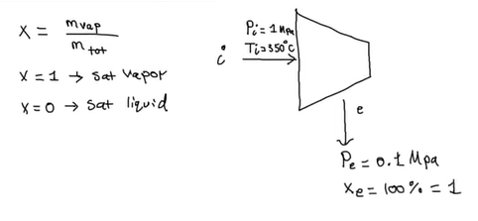
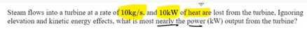
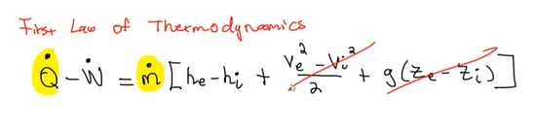
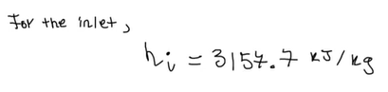
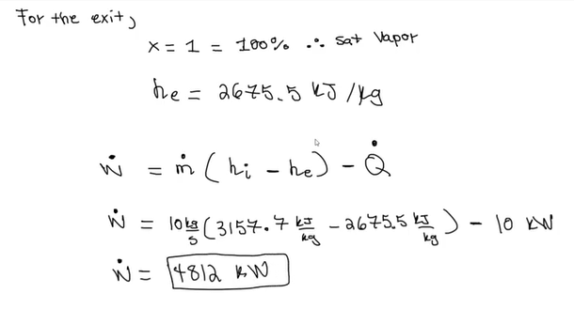
Problem 1
For Steady-Flow Systems on page 148 of the FE Handbook:
Page 158 from the FE handbook
KE
PE

Slide 3
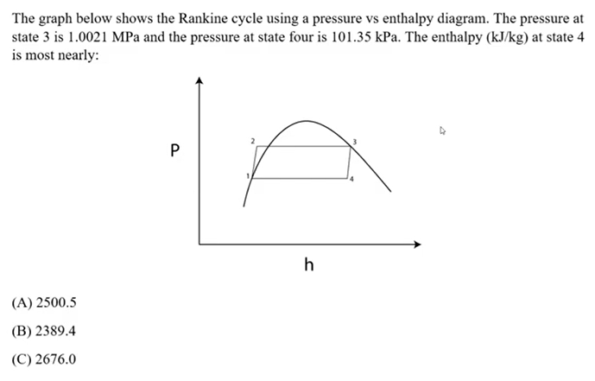

Problem 2

Slide 4
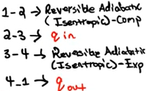
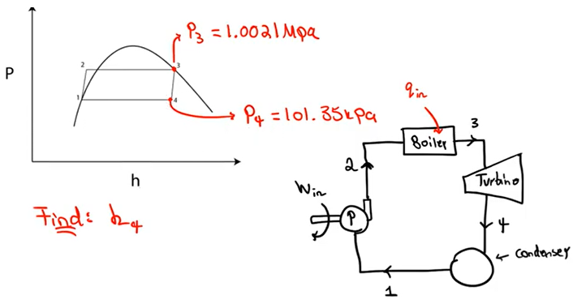
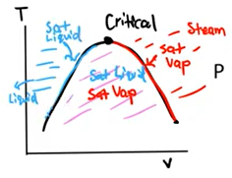
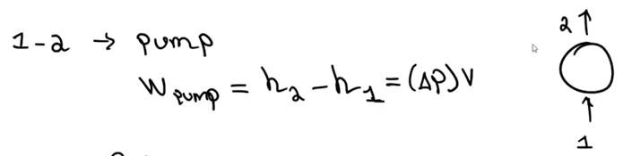
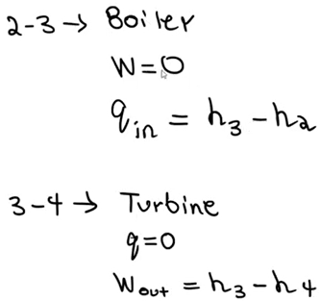
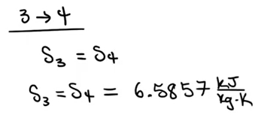
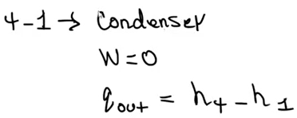
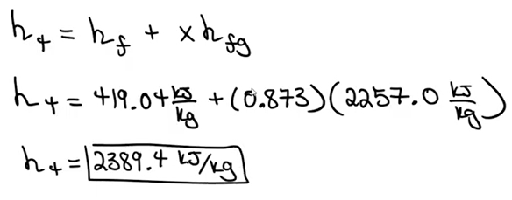
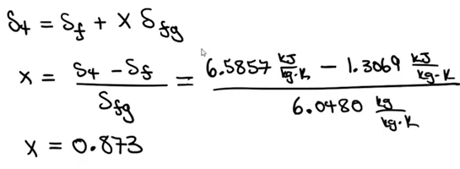


Problem 2
Need to calculate quality, x, from page 144 of the FE Handbook

Slide 5
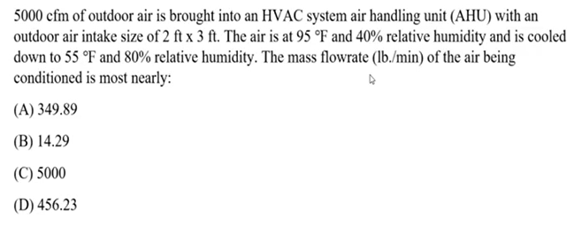

Problem 3

Slide 6
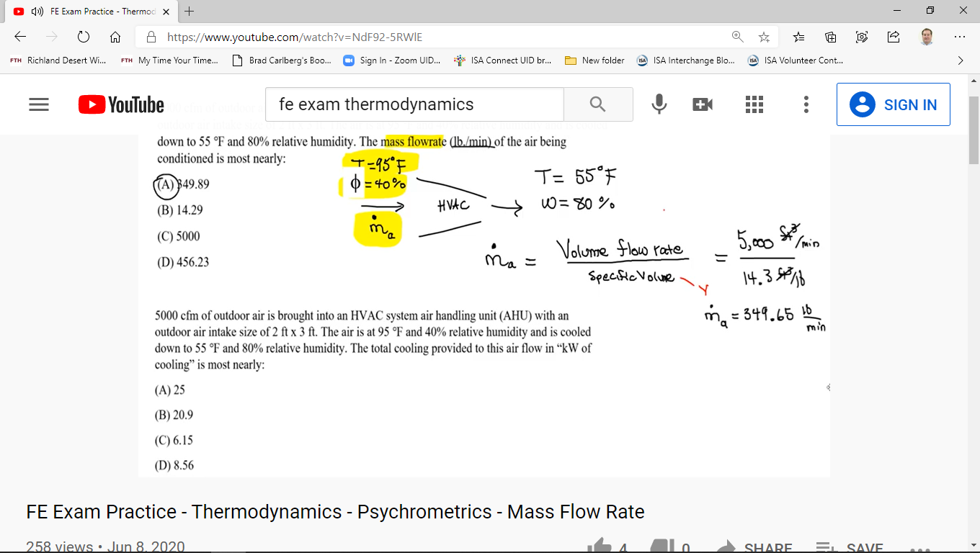
Problem 3
From psychrometric chart on page 176 of FE Handbook

Slide 7
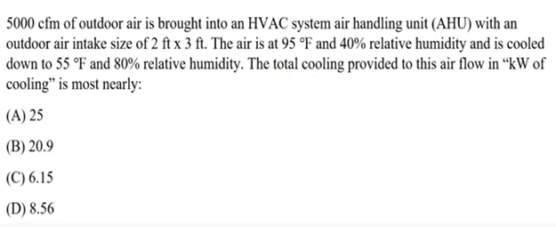
Problem 4

Slide 8
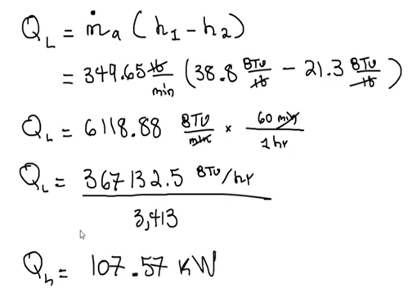
Problem 4

Slide 9
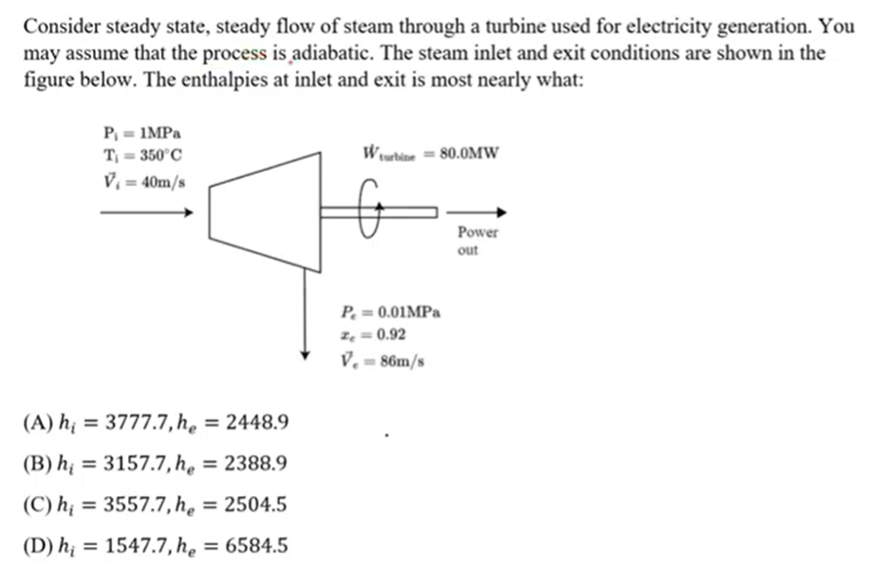
Problem 5

Slide 10
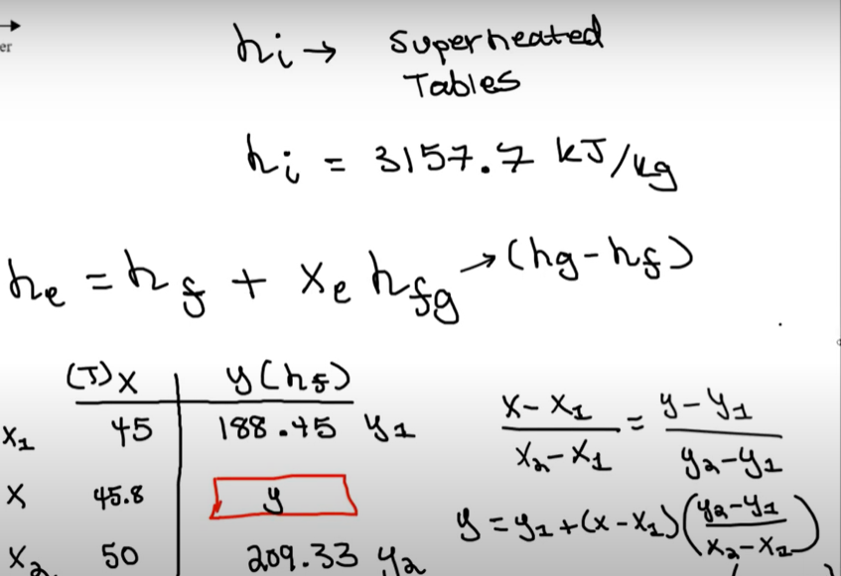
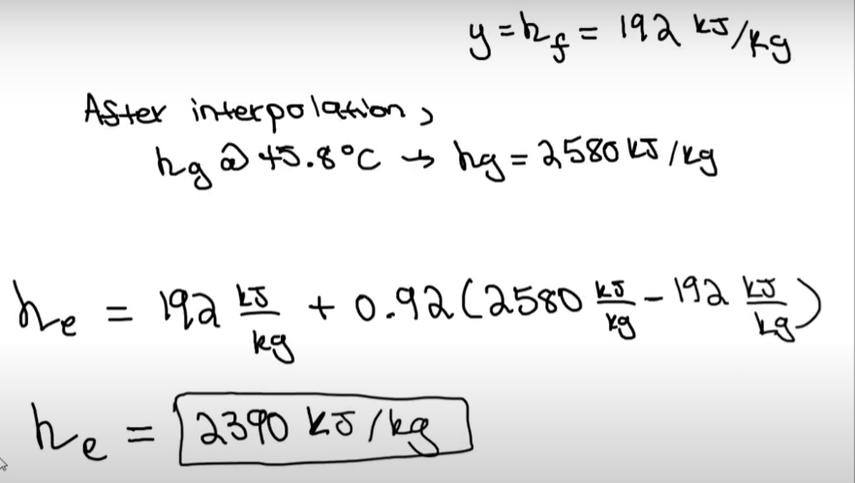
Problem 5

Slide 11
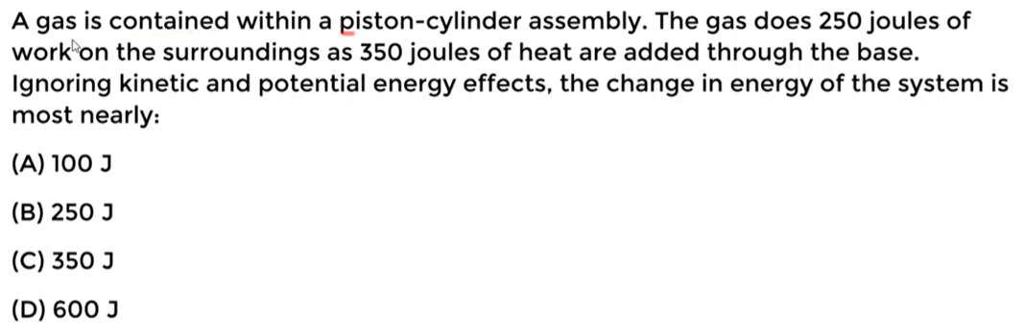
Problem 6

Slide 12
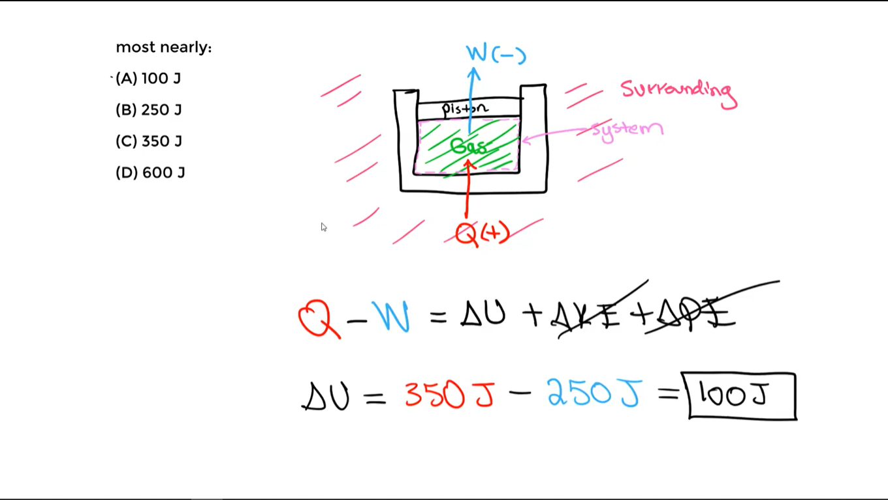
Problem 6

Slide 13
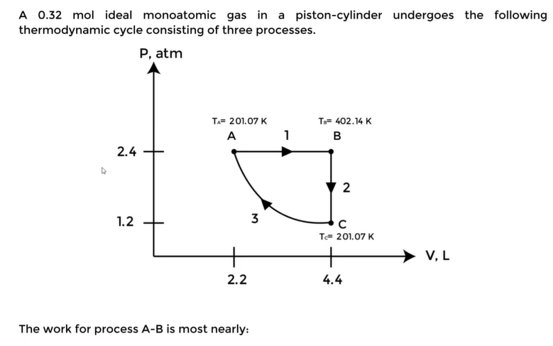
Problem 7

Slide 14
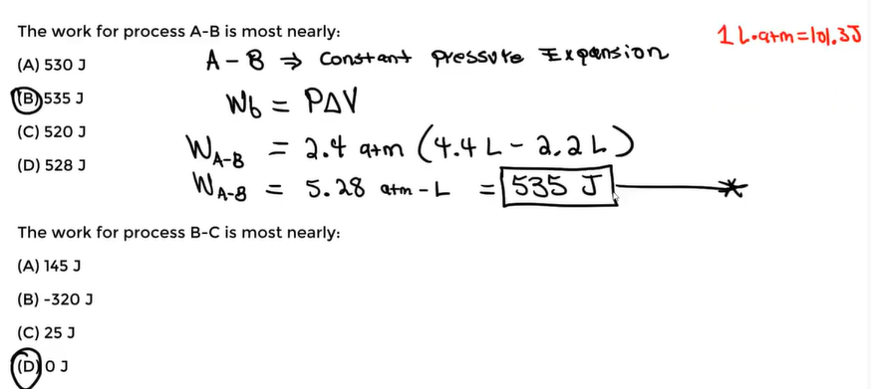
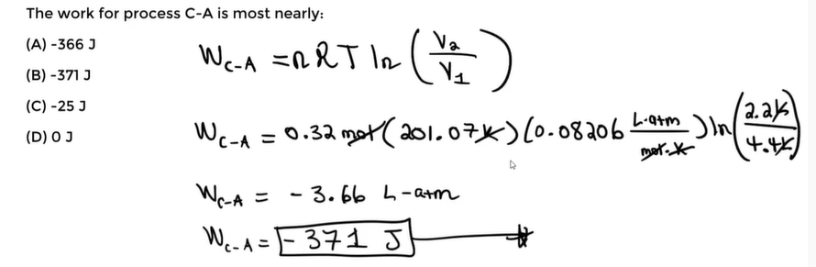
Problem 7

Slide 15
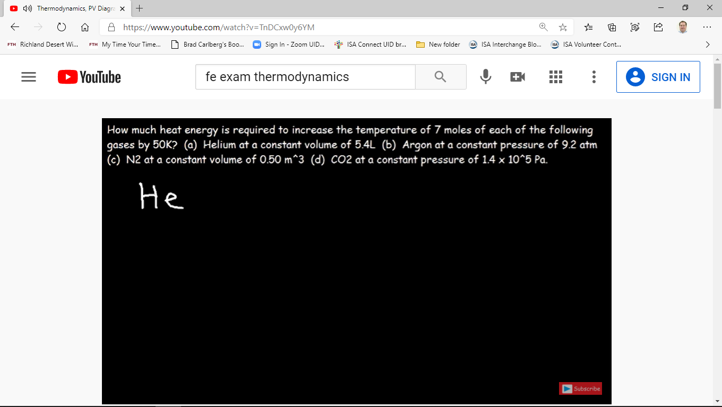
Problem 8

Slide 16
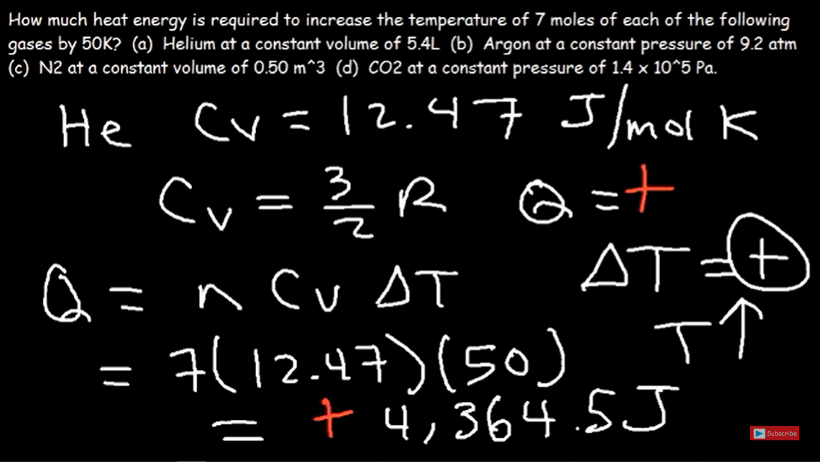
Problem 8

Slide 17
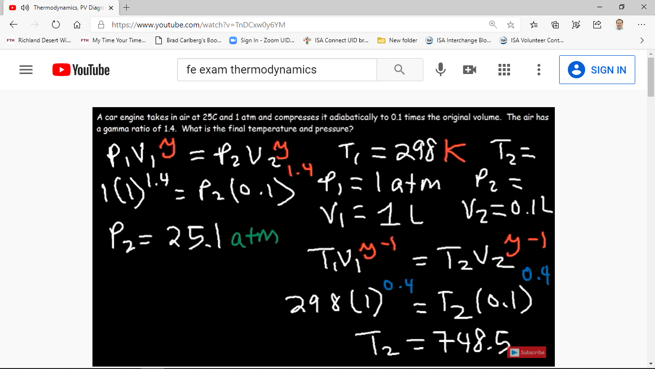
Problem 9

Slide 18
Problem 9

Slide 19
Problem 10

Slide 20
Problem 10

Slide 21
Problem 1

Slide 22
Problem 1

Slide 23
Problem 2

Slide 24
Problem 2

Slide 25
Problem 3

Slide 26
Problem 3

Slide 27
Problem 4

Slide 28
Problem 4

Slide 29
Problem 5

Slide 30
Problem 5

Slide 31
Problem 6

Slide 32
Problem 6

Slide 33
Problem 7

Slide 34
Problem 7

Slide 35
Problem 8

Slide 36
Problem 8

Slide 37
Problem 9

Slide 38
Problem 9

Slide 39
Problem 10

Slide 40
Problem 10

