Slide 1
CHEMISTRY & BIOLOGY
FE/EIT Exam Review Course
22 May 2024

Slide 2
5. Chemistry and Biology 7–11 CHEMICAL CBT Exam
  Inorganic chemistry (e.g., molarity, normality, molality, acids, bases, redox reactions, valence, solubility product, pH, pK, electrochemistry, periodic table)
  Organic chemistry (e.g., nomenclature, structure, balanced equations, reactions, synthesis)
  Analytical chemistry (e.g., wet chemistry and instrumental chemistry)
  Biochemistry, microbiology, and molecular biology (e.g., organization and function of the cell; Krebs, glycolysis, Calvin cycles; enzymes and protein chemistry; genetics; protein synthesis, translation, transcription)
  Bioprocessing (e.g., fermentation, biological treatment systems, aerobic, anaerobic process, nutrient removal)
6. Environmental Chemistry 7–11 ENVIRONMENTAL CBT Exam
  Stoichiometry and chemical reactions (e.g., equilibrium, acid-base, oxidation-reduction, precipitation, pC-pH)
  Kinetics (e.g., chemical conversion, growth and decay)
  Organic chemistry (e.g., nomenclature, functional group reactions)
  Multimedia equilibrium partitioning (e.g., Henry’s law, octanol partitioning coefficient)
3. Chemistry 5–8 OTHER DISCIPLINES CBT Exam
  Oxidation and reduction (e.g., reactions, corrosion control)
  Acids and bases (e.g., pH, buffers)
  Chemical reactions (e.g., stoichiometry, equilibrium, bioconversion)
Agenda

Slide 3
Molarity
Normality
Molality
Acids & bases, pH, buffers
oxidation-reduction reactions
Valence
solubility product
pH & pK
Electrochemistry
periodic table
Inorganic chemistry

Slide 4
Check on Learning
Problem 4
4. A lab technician is preparing a chemical standard and has the following laboratory equipment and glassware.
Volumetric flask 100 ml ± 0.1 ml
Analytical balance 100 g ± 0.001 g
Glass pipette 1 ml ± 0.01 ml
The technician first weighs out 10 g of solids and dissolves them in 100 ml of water. Then the technician dilutes 1 ml of the solution to 100 ml using best laboratory practices. What is the number of significant figures of the molarity of the final solution?
o A. 1
o B. 2
o C. 3
o D. 4
4. Refer to the Chemistry and Biology chapter of the FE Reference Handbook & the FE Chemical Practice Exam.
Volume = 100.1 ml, 4 significant figures
Weight = 100.1 g, 4 significant figures
Pipette = 1.001 ml 4 significant figures
THE CORRECT ANSWER IS: D

Slide 5
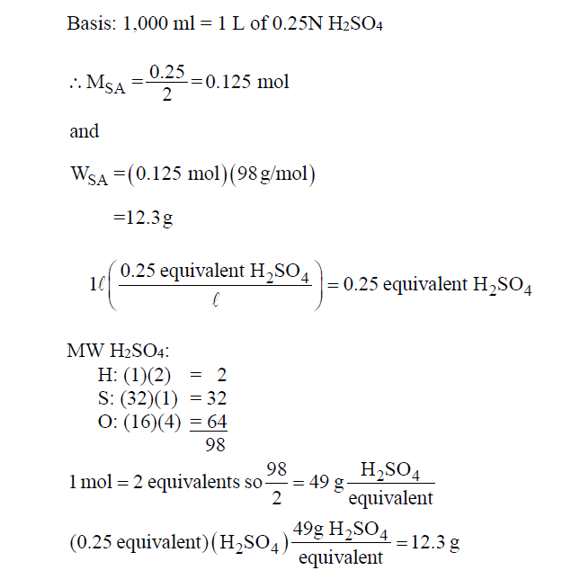
Check on Learning
17.A. The mass (g) of H2SO4 required to produce 1,000 mL of 0.25N H2SO4 is most nearly:
o A. 12.3
o B. 24.5
o C. 49.0
o D. 98.0
17.A. Refer to the Definitions section in the Chemistry and Biology chapter of the FE Reference Handbook.
THE CORRECT ANSWER IS: A

Slide 6
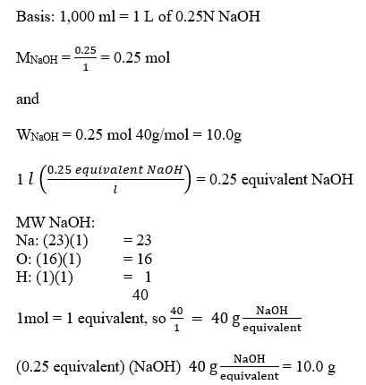
Check on Learning
17.A. The mass (g) of NaOH required to produce 1,000 mL of 0.25N NaOH is most nearly:
o A. 10.0
o B. 20.0
o C. 40.0
o D. 80.0
Concentrated Reagent | Formula Weight¹ | Density | Approx.² Strength | Molarity (M) | Normality (N) | Volume (mL) required to make 1000 mL solution³
 |  |  |  |  |  | 1 M |  | 1 N
Acetic Acid (CH₃COOH) | 60.052 | 1.05 | 99.8% | 17.4 | 17.4 | 57.5 | 57.5
Formic Acid (HCOOH) | 46.026 | 1.13 | 90% | 23.6 | 23.6 | 42.5 | 42.5
Hydrochloric Acid (HCl) | 36.461 | 1.18 | 37.2% | 12.1 | 12.1 | 82.5 | 82.5
Hydrofluoric Acid (HF) | 20.006 | 1.19 | 49% | 28.9 | 28.9 | 34.5 | 34.5
Nitric Acid (HNO₃) | 63.013 | 1.41 | 69.6% | 15.6 | 15.6 | 64 | 63
Perchloric Acid (HClO₄) | 100.46 | 1.67 | 70.5% | 11.7 | 11.7 | 85.5 | 85.5
Perchloric Acid (HClO₄) | 100.46 | 1.67 | 61.3% | 9.5 | 9.5 | 105.5 | 105.5
Phosphoric Acid (H₃PO₄) | 97.995 | 1.71 | 85.5% | 14.8 | 44.4 | 67.5 | 22.5
Sulfuric Acid (H₂SO₄) | 98.073 | 1.84 | 96% | 18 | 36 | 55.5 | 28
Ammonium Hydroxide (NH₄OH) | 35.046 | 0.90 | 56.6%⁴ | 14.5 | 14.5 | 69 | 69
Sodium Hydroxide (NaOH) | 39.997 | 1.53 | 50.5% | 19.4 | 19.4 | 51.5 | 51.5
Potassium Hydroxide (KOH) | 56.105 | 1.45 | 45% | 11.7 | 11.7 | 85.5 | 85.5
17.B. Refer to the Definitions section in the Chemistry and Biology chapter of the FE Reference Handbook.
1. Based on Atomic Weight Table (32 C = 12).
2. Representative value, w/w %.
3. Rounded to nearest 0.5ml.
4. Equivalent to 28.0% w/w NH₃.
THE CORRECT ANSWER IS: A

Slide 7
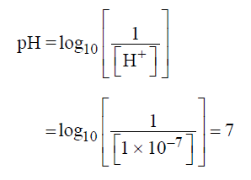
Check on Learning
16. What is the pH of water?
o A. -7
o B. 0
o C. 7
o D. 14
16. Refer to the Acids, Bases, and pH (aqueous solutions) section in the Chemistry chapter of the FE Reference Handbook.
[H+] = molar concentration of hydrogen ion, in gram moles per liter. Acids have pH < 7. Bases have pH > 7.
THE CORRECT ANSWER IS: C

Slide 8
Check on Learning
19. Five columns—C1, C2, C3, C4, and C5—are labeled below in the Periodic Table of Elements.
Select the columns that contain an element that could have either a +3 or –3 charge?
19. Refer to the Periodic Table of Elements in the Chemistry and Biology chapter of the FE Reference Handbook & the FE Chemical Practice Exam. Elements in C3 (iron group) and C4 (boron group) contain elements that could have +3 or –3 charge.
THE CORRECT ANSWERS ARE: C3, C4

Slide 9
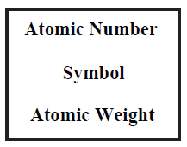
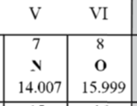
Check on Learning
20. Nitrogen gas, N₂, is used to “pad” enclosed storage tanks to mitigate the risk of explosions by displacing the Oxygen gas, O₂, that could facilitate the combustion. Nitrogen “padding” works because the Atomic Weight of Nitrogen is lighter/heavier than Oxygen.
28
The atomic weights of Nitrogen gas is & Oxygen gas is :
o A. 16 Lbs/Mole
o B. 28 Lbs/Mole
o C. 32 Lbs/Mole
o D. 14 Lbs/Mole
28
32
Looking at the “3-lined” box in the center of the Periodic Table, The atomic number is the number of protons in the atomic nucleus; and the atomic weight is the mass per mole of gas.

Slide 10
Nomenclature
Structure
balanced equations
Reactions
Synthesis
functional group reactions
Organic chemistry

Slide 11
wet chemistry
instrumental chemistry
Analytical chemistry

Slide 12
organization and function of the cell
Krebs
Glycolysis
Calvin cycles
enzymes and protein chemistry
Genetics
protein synthesis
Translation
transcription
Biochemistry, microbiology, and molecular biology

Slide 13
Bioconversion
Fermentation
biological treatment systems
Aerobic processes
anaerobic processes
nutrient removal
Bioprocessing

Slide 14
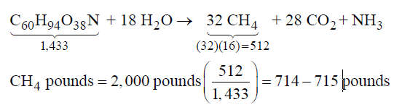
Check on Learning
24. The balanced equation and molecular weights for reactants and products in the anaerobic
digestion of an organic material are as follows:
C₆₀H₉₄O₃₈N + 18 H₂O 32 CH₄ + 28 CO₂ + NH₃
Compound | MW
C₆₀H₉₄O₃₈N | 1,433
H₂O | 18
CH₄ | 16
CO₂ | 44
NH₃ | 17
The weight (lb) of methane produced per 2,000 lb of organic material would be most
nearly__________.
THE CORRECT ANSWER IS: 714–715
24. Refer to the Bioconversion section of the Chemistry and Biology chapter of the FE Reference Handbook & the FE Chemical Practice Exam.

Slide 15
Equilibrium
acid-base
oxidation-reduction
Precipitation
pC-pH
Stoichiometry and chemical reactions

Slide 16

Check on Learning
18. Consider the following equation:
The equation above is the formulation of the chemical equilibrium constant equation for which of the following reactions?
o A. C2 + D2 ↔ A4 + B
o B. 4A + B ↔ 2C + 2D
o C. 4C + 2D ↔ 2A + B
o D. A4 + B ↔ C2 + D2
18. Refer to the Chemistry chapter of the FE Reference Handbook for the equilibrium constant of a
chemical reaction.
4A + B ↔ 2C + 2D
THE CORRECT ANSWER IS: B

Slide 17
Check on Learning
19. Place the numbers in the correct position in the equation to balance the reaction. Some numbers may be used more than once.
_____ CH4 + _____ O2 → _____ CO2 + _____ H2O
1 2 3 4
19. Refer to the Chemistry chapter of the FE Reference Handbook.
In a balanced reaction, the number of atoms of each element must be the same on both sides of the reaction.
Carbon: A*1 + B*0 = C*1 + D*0 A = C
Hydrogen: A*4 + B*0 = C*0 + D*2 2A = D
Oxygen: A*0 + B*2 = C*2 + D*1 2B = 2C + D
Let A = 1, then C = 1
      D = 2
      B = 2
CH4 + 2O2 → CO2 + 2H2O
1 CH4 + 2 O2 → 1 CO2 + 2 H2O
THE CORRECT ANSWERS ARE SHOWN ABOVE.

Slide 18
chemical conversion
growth & decay
Kinetics

Slide 19
Henry’s law
octanol partitioning coefficient
Multimedia equilibrium partitioning

Slide 20
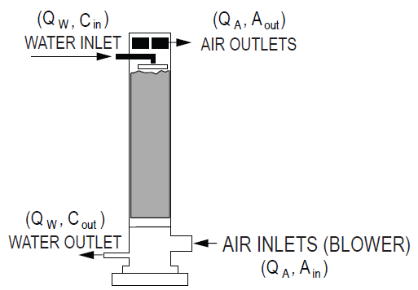
Air Stripping
P_{i} = HC_{i} = Henry's Law
P_{i} = partial pressure of component i (atm)
H = Henry's Law constant (atm-m³/kmol)
C_{i} = concentration of component i in solvent (kmol/m³)
A_{out} = H'C_{in}
Q_{W} • C_{in} = Q_{A} H'C_{in}
Q_{W} = Q_{A} H'
H' (Q_{A} / Q_{W}) = 1
where
A_{out} = concentration in the effluent air (kmol/m3); in this formulation of the equation Ain and Cout are assumed to be negligible for simplicity.
Q_{W} = water flow rate (m³/s)
Q_{A} = airflow rate (m³ /s)
A_{in} = concentration of contaminant in air (kmol/ m³)
C_{out} = concentration of contaminants in effluent water (kmol/ m³)
Cin = concentration of contaminants in influent water (kmol/ m³)
21. Refer to the Environmental Engineering chapter of the FE Reference Handbook.
THE CORRECT ANSWERS ARE SHOWN ABOVE.

Slide 21


Stripper Packing Height = Z
Z = HTU × NTU
Assuming rapid equilibrium
where
NTU = number of transfer units
H = Henry's Law constant
H′ = H/RT = dimensionless Henry's Law constant
T = temperature in units consistent with K
R = universal gas constant [atm•m3/(kmol•K)]
RS = stripping factor H′(QA/QW)
Cin = concentration in the influent water (kmol/m3)
Cout = concentration in the effluent water (kmol/m3)
HTU = Height of Transfer Units =
where
L = liquid molar loading rate [kmol/(s•m2)]
MW = molar density of water (55.6 kmol/m3) = 3.47 lbmol/ft3
KLa = overall transfer rate constant (s–1)

Slide 22

Check on Learning
20. The production of Polychlorinated biphenyls (PCBs), highly carcinogenic chemical compounds formerly used in industrial and consumer products, was banned in the United States by the Toxic Substances Control Act in 1976 and internationally by the Stockholm Convention because they have high log K_{ow} , octanol-partition coefficients, & tend to accumulate in the fatty tissue of organisms (bioaccumulation).
PCBs are: A. hydrophilic B. claustrophobic C. lipophilic D. hydrophobic
Option A. False
Option B. False
Option C. True
Option D. True
20. Refer to the Environmental Engineering chapter of the FE Reference Handbook.
Values for log K_{ow} typically range between -3 (very hydrophilic) and +10 (extremely lipophilic/hydrophobic).
For a compound X, the octanol/water partition coefficient is described by the formula:
(square brackets indicate molar concentrations)
Octanol-water partition coefficient is typically expressed in logarithm form and is indicated as log K_{ow} or log P.
The n-octanol-water partition coefficient, K_{ow} , is a partition coefficient for the two-phase system consisting of n-octanol and water. K_{ow} is also frequently referred to by the symbol P, especially in the English literature. It is also called n-octanol-water partition ratio. K_{ow} serves as a measure of the relationship between lipophilicity (fat solubility) and hydrophilicity (water solubility) of a substance. The value is greater than one if a substance is more soluble in fat-like solvents such as n-octanol, and less than one if it is more soluble in water. If a substance is present as several chemical species in the octanol-water system due to association or dissociation, each species is assigned its own K_{ow} value. A related value, D, does not distinguish between different species, only indicating the concentration ratio of the substance between the two phases.
THE CORRECT ANSWERS ARE SHOWN ABOVE.

