Slide 1
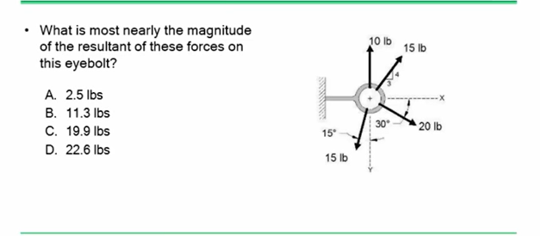
Problem 1

Slide 2
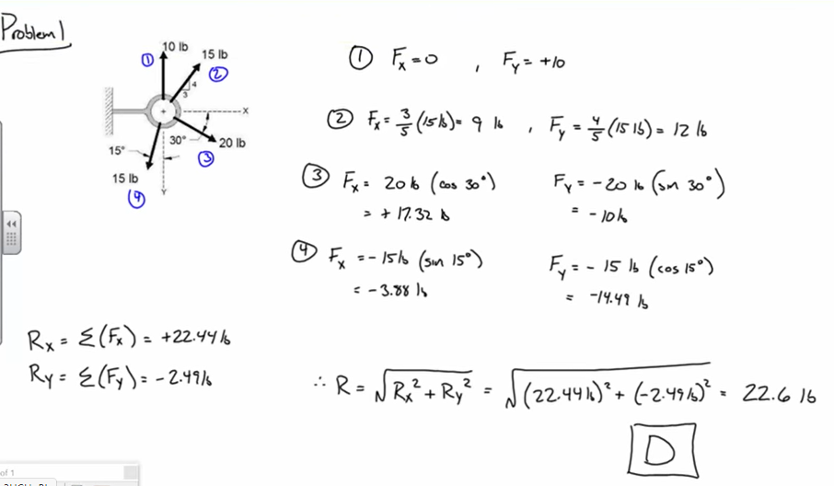
Problem 1

Slide 3
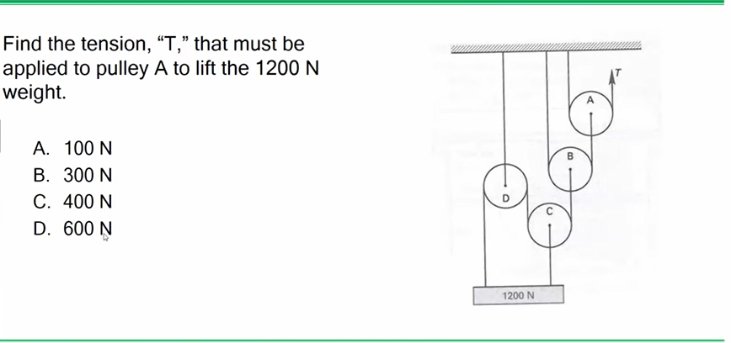
Problem 2

Slide 4
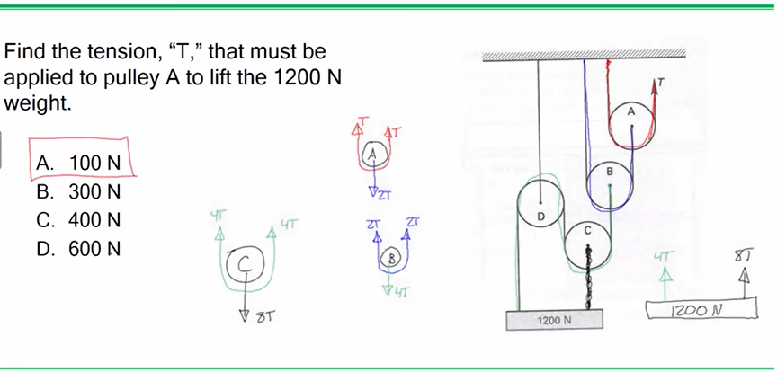
Problem 2

Slide 5
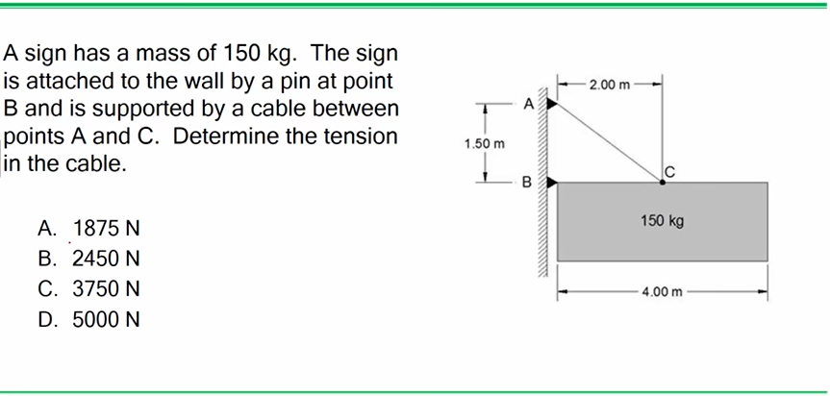
Problem 3

Slide 6
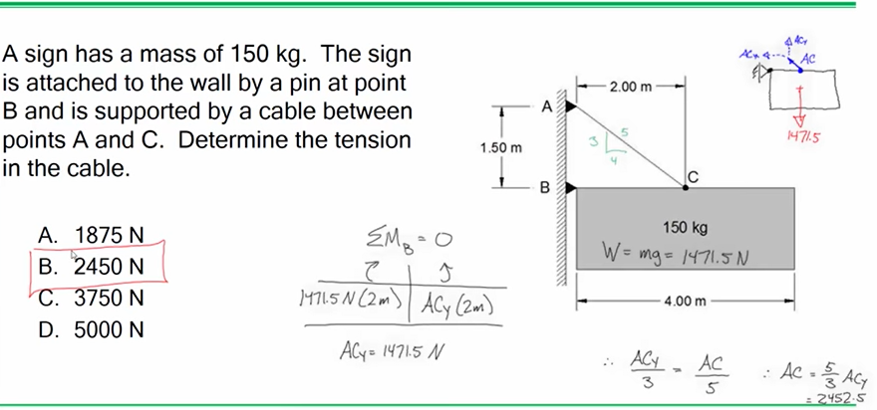
Problem 3

Slide 7
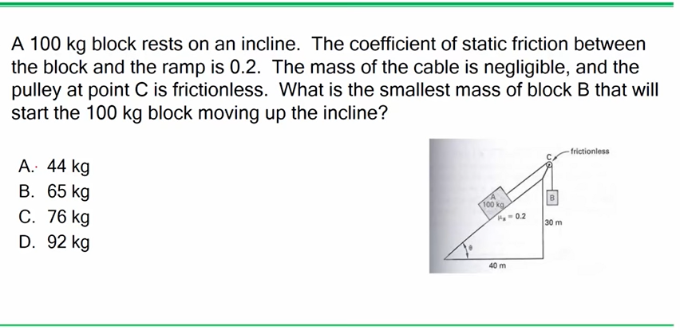
Problem 4

Slide 8
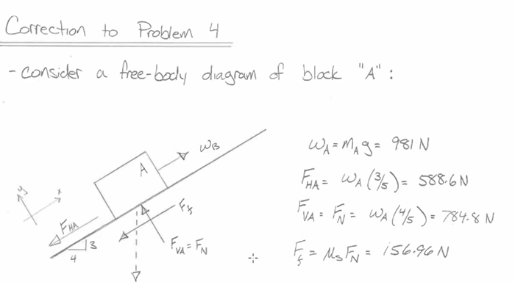
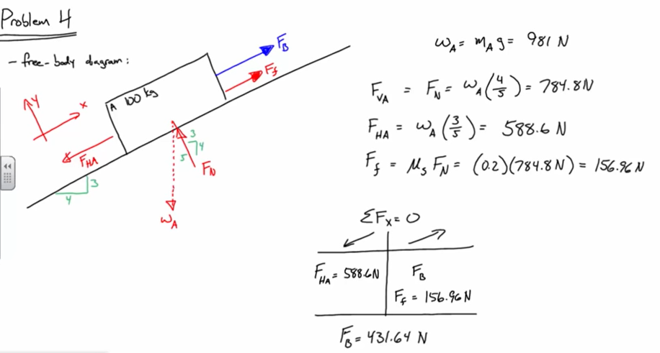
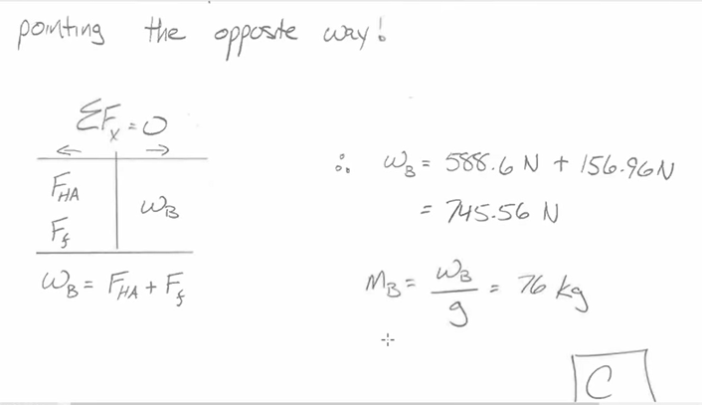
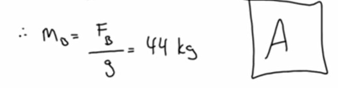
Problem 4

Slide 9
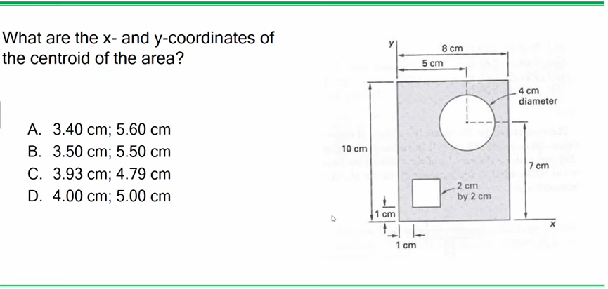
Problem 5

Slide 10
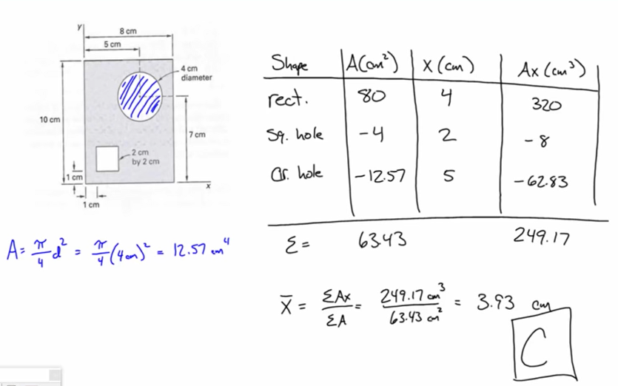
Problem 5

Slide 11
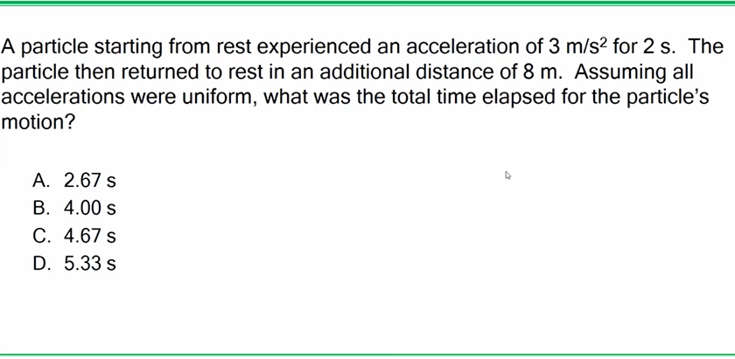
Problem 6

Slide 12
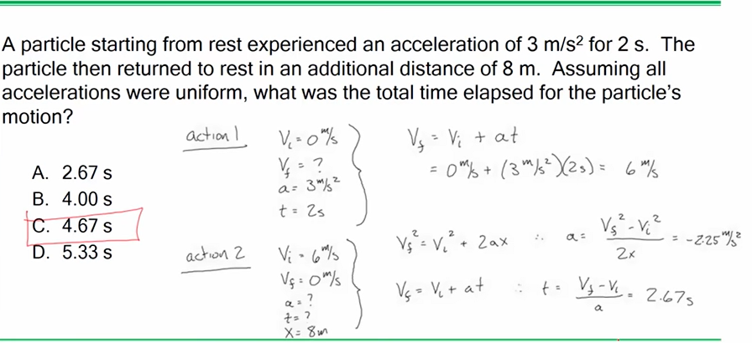
Problem 6

Slide 13
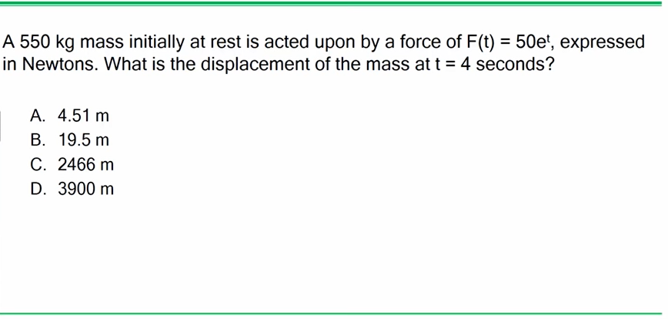
Problem 7

Slide 14
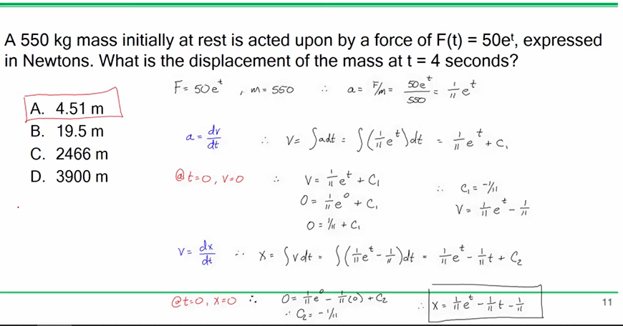
Problem 7

Slide 15
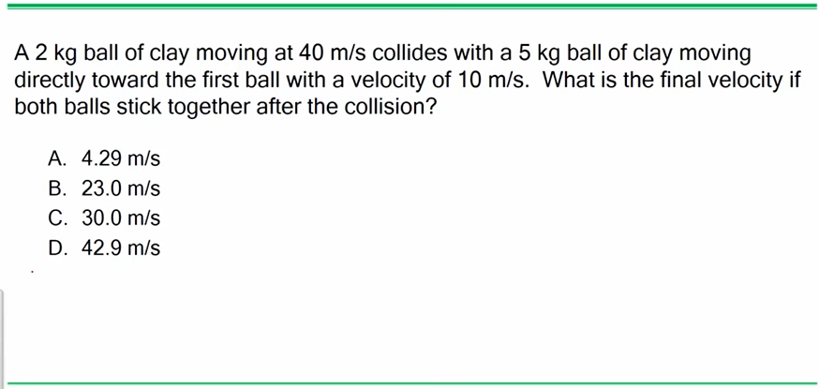
Problem 8

Slide 16
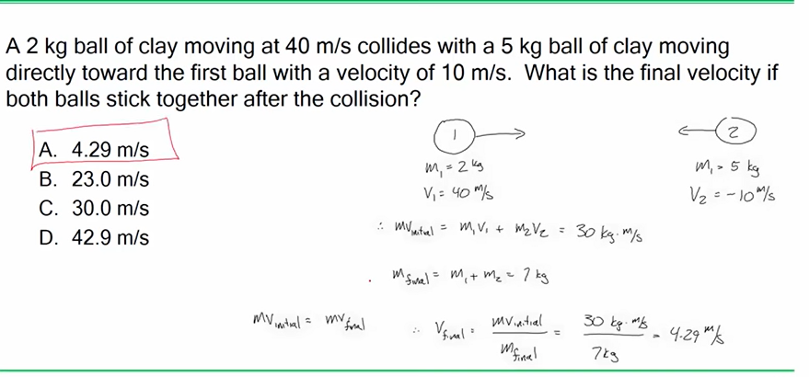
Problem 8
Conservation of momentum

Slide 17
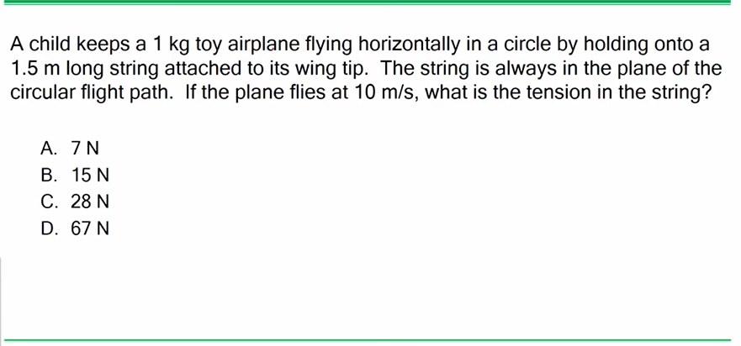
Problem 9
Page 116 – Plane Circular Motion - mv^2/r

Slide 18
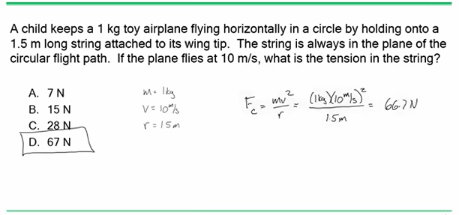
Problem 9

Slide 19
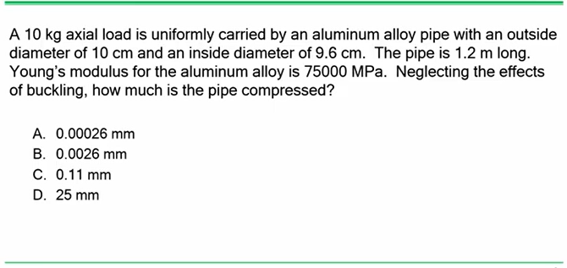
Problem 10

Slide 20
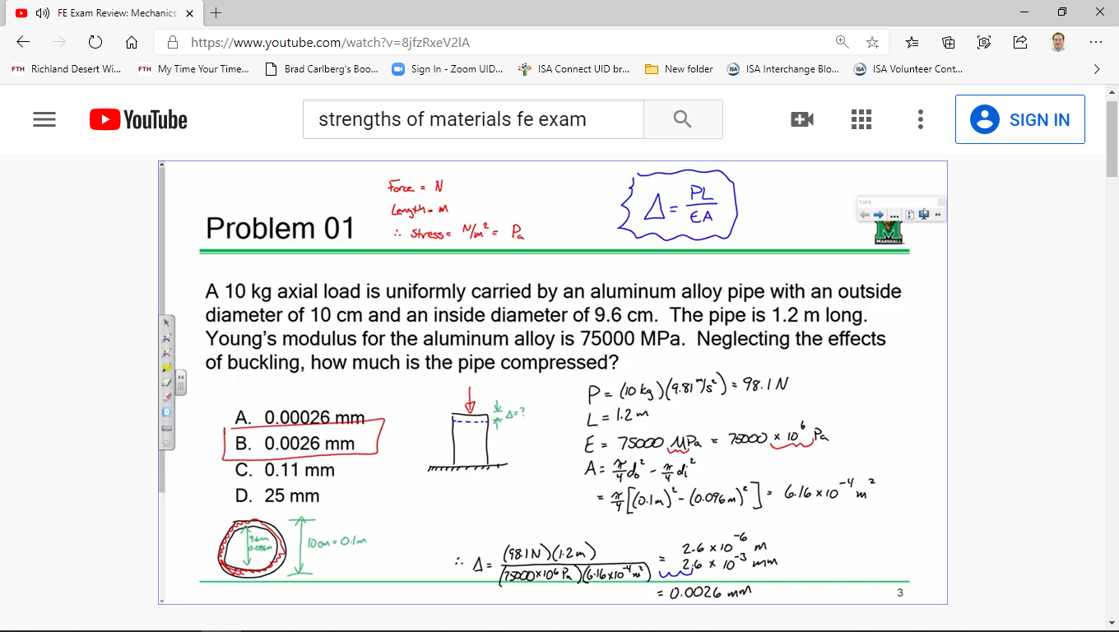
Problem 10

Slide 21
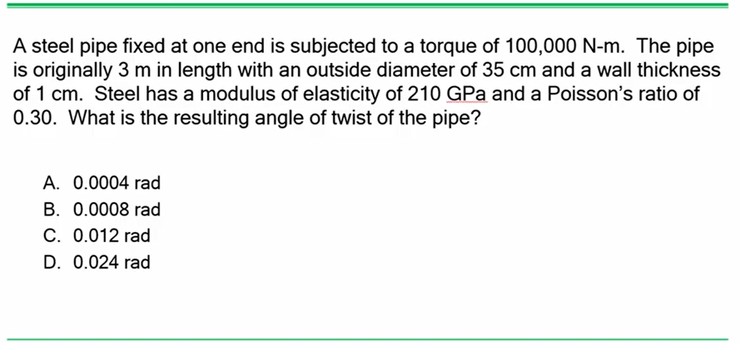
Problem 11

Slide 22
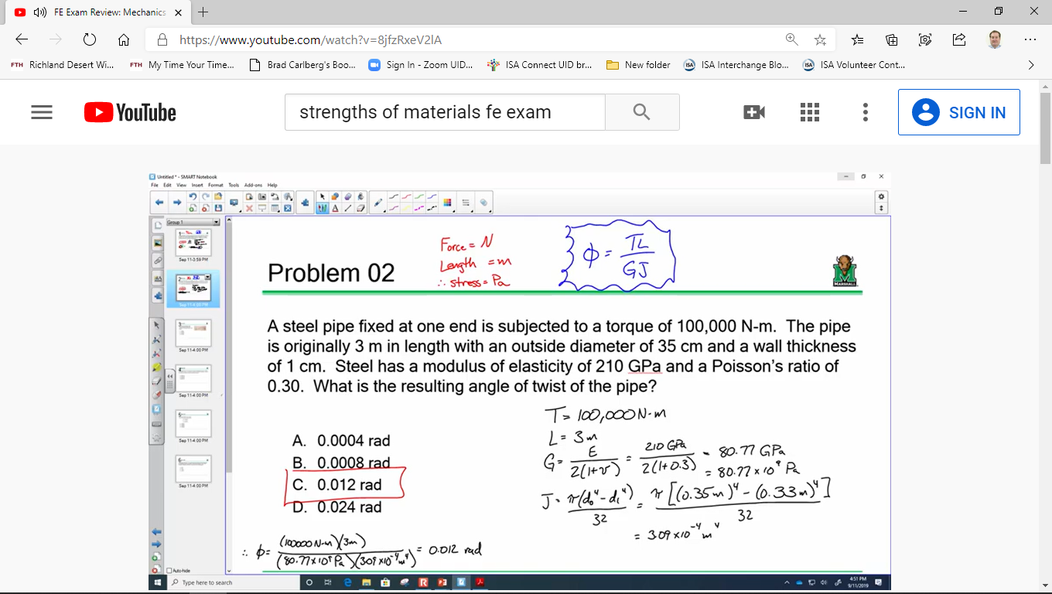
Problem 11

Slide 23
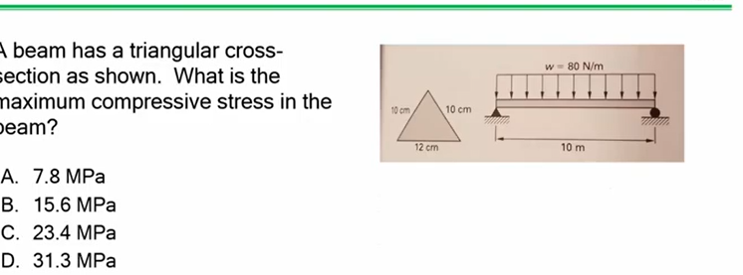
Problem 12

Slide 24
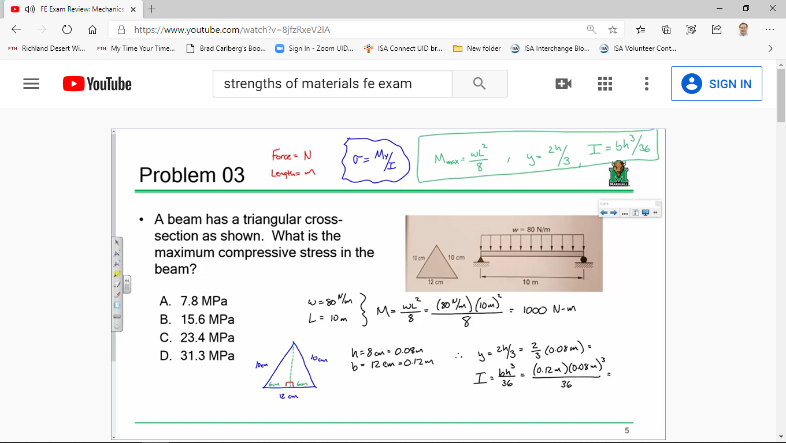
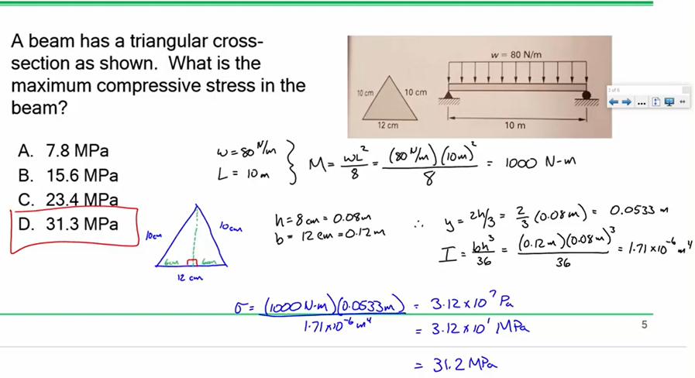
Problem 12

Slide 25
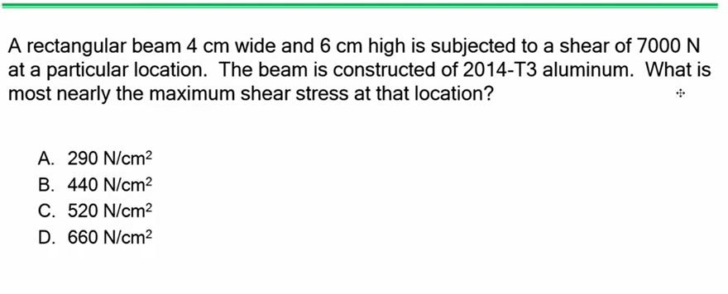
Problem 13

Slide 26
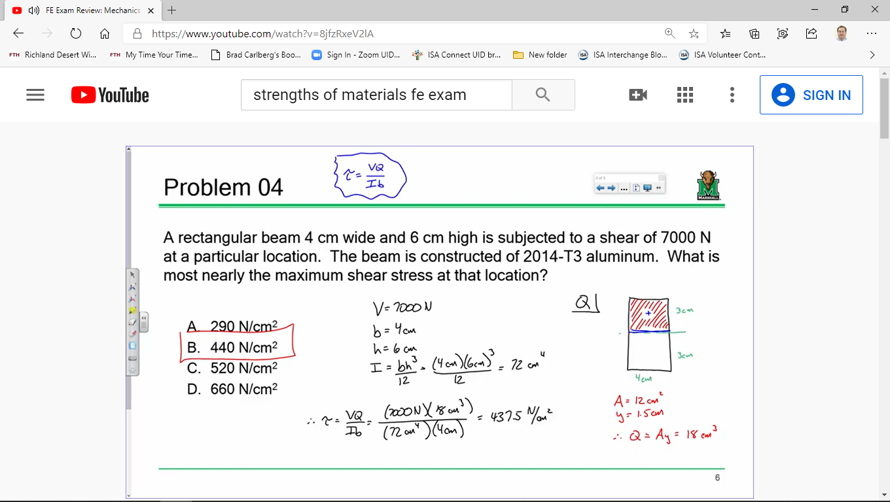
Problem 13

Slide 27
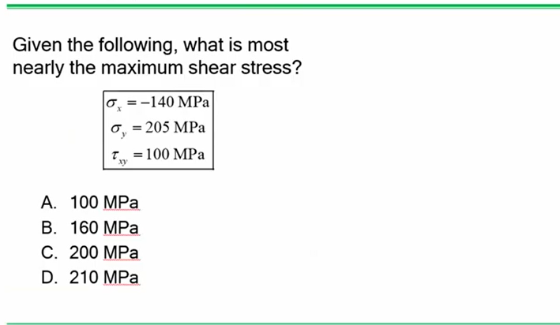
Problem 14

Slide 28
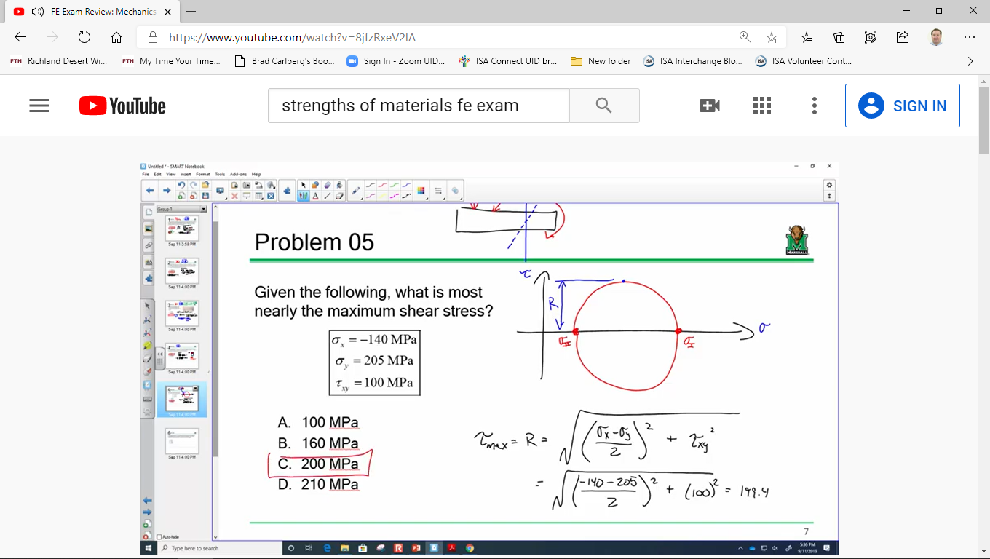
Problem 14

Slide 29
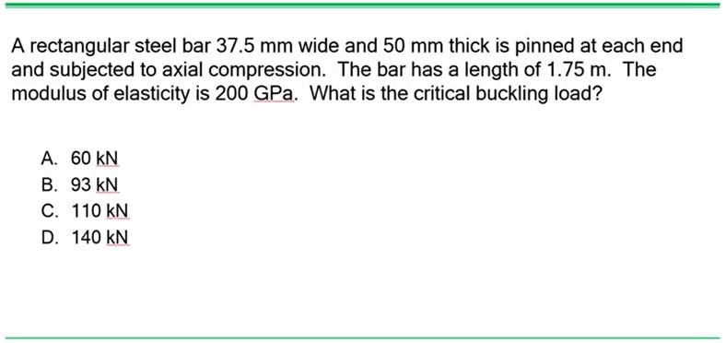
Problem15

Slide 30
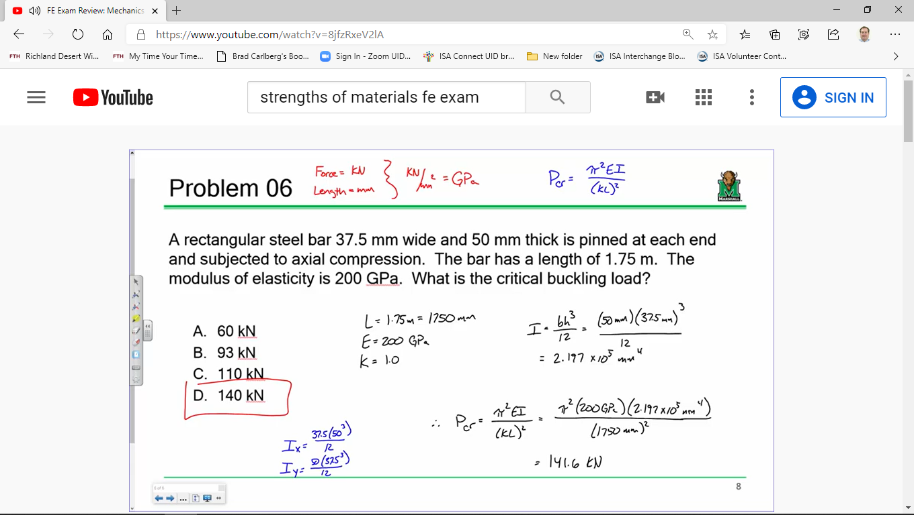
Problem 15

Slide 31
Problem 15
15. A 0.25-m steel rod with a cross-sectional area of 1,250 mm2 and a modulus of elasticity E of
200 GPa is subjected to a 5,000-N force as shown below. The elongation of the rod (μm) is most
nearly:
o A. 2.4
o B. 4.4
o C. 5.0
o D. 9.6

Slide 32
Problem 15
From the Uniaxial Loading and Deformation section in the Mechanics of Materials chapter of the
FE Reference Handbook, the uniaxial deformation is:
THE CORRECT ANSWER IS: C

Slide 33
Problem 16
16. In general, a metal with high hardness will also have which of the following characteristics?
Select all that apply.
□ A. Good formability
□ B. Strong intermolecular bonding
□ C. High tensile strength
□ D. High yield strength
□ E. High oxygen permeability
□ F. High abrasion/scratch resistance

Slide 34
Problem 16
Refer to the Relationship Between Hardness and Tensile Strength section in the Mechanics of
Materials chapter of the FE Reference Handbook.
By definition, a metal with high hardness has a high tensile and yield strength, as well as strong
intermolecular bonding, with high impact, rebound, and scratch resistance strength.
THE CORRECT ANSWERS ARE: B, C, D, AND F

Slide 35
Problem 17
17. If an aluminum crimp connector were used to connect a copper wire to a battery, what would
most likely happen?
o A. Only the copper wire will corrode.
o B. Only the aluminum connector will corrode.
o C. Both will corrode.
o D. Nothing

Slide 36
Problem 17
Refer to the Corrosion section in the Mechanics of Materials chapter of the FE Reference
Handbook. Aluminum is anodic relative to copper and therefore will corrode to protect the
copper.
THE CORRECT ANSWER IS: B

Slide 37
Problem 18
18. Glass is said to be an amorphous material. This means that it:
o A. has a high melting point
o B. is a supercooled vapor
o C. has large cubic crystals
o D. has no apparent crystal structure

Slide 38
Problem 18
Refer to the Amorphous Materials section in the Mechanics of Materials chapter of the
FE Reference Handbook. By definition, amorphous materials do not have a crystal structure.
THE CORRECT ANSWER IS: D

Slide 39
Problem 94
The pressure gauge in an air cylinder reads 1,680 kPa. The cylinder is constructed of a 12-mm
rolled-steel plate with an internal diameter of 700 mm. The tangential (hoop) stress (MPa) inside
the tank is most nearly:
o A. 25
o B. 50
o C. 77
o D. 100

Slide 40
Problem 94
Refer to page 132 in the Cylindrical Pressure Vessel section in the Mechanics of Materials chapter of the
FE Reference Handbook.
The cylinder can be considered thin-walled if t < do/20. In this case, t = 12 mm and
ro = do/2 = 362 mm. Thus, the σ_{t} = tangential (hoop) stress is:
THE CORRECT ANSWER IS: B

Slide 41
Problem 95
What is the total longitudinal strain in a 1m long where Young's modulus (the modulus of elasticity), E, is 210 GPa and Poisson's ratio, ν, = 0.24
σ_{l} = 23.1 MPa
σ_{t} = 46.2 MPa
σ_{r} = 0

Slide 42
Problem 95
Refer to the Hooke's Law section in the Mechanics of Materials chapter on page 134 of the FE Reference Handbook.
The formula for the total longitudinal strain without a temperature rise is:
ε_{l} = 1/E[σ_{l} - ν (σ_{t} - σ_{r} )]
where Young's modulus (the modulus of elasticity), E, = 210 GPa
& Poisson's ratio, ν, = 0.24
, where is the length of the section under consideration
= 5.72 × 10⁻⁶ × 1,000 mm
= 0.0572 mm
THE CORRECT ANSWER IS: A

